Slide 1
Building Continuous Delivery Pipelines
Better Software West 2018
Ken Mugrage - ThoughtWorks

Slide 2
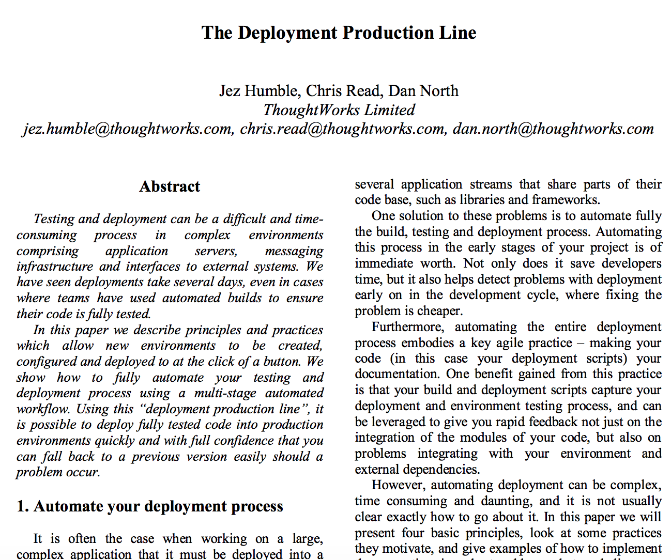
A bit of history
White paper presented at Agile 2006 describing a production line approach to software
https://continuousdelivery.com/wp-content/uploads/2011/04/deployment_production_line.pdf

Slide 3
DevOps
2008 – Agile Toronto
2009 – DevOpsDays Ghent
2011 – The Phoenix Project
2016 – The DevOps Handbook
Where did the word come from?

Slide 4
CAMS
Culture
Automation
Measurement
Sharing

Slide 5
CALMS
Culture
Automation
LEAN
Measurement
Sharing

Slide 6
My Definition of DevOps
DevOps: A culture where people, regardless of title or background, work together to imagine, develop, deploy and operate a system.

Slide 7
CD Book

Slide 8
CD Definition
Continuous Delivery is the ability to get changes of all types—including new features, configuration changes, bug fixes and experiments—into production, or into the hands of users, safely and quickly in a sustainable way.
Jez Humble - https://continuousdelivery.com/

Slide 9
Agile 101

Slide 10
Agile 101

Slide 11
Agile 101

Slide 12
pipelines
Delivery Team
Commit
Build and Unit Tests
Automated Acceptance
User Acceptance
Deploy

Slide 13
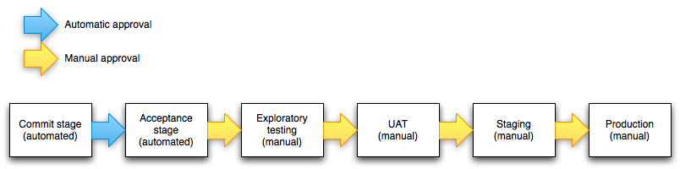
Improper practices
Creating CD pipelines the same way you created CI workflows leads to inflexibility
The CI portion of this pipeline would normally be relatively fast
The CD portion of this pipeline would normally be much longer
http://continuousdelivery.com/2010/09/deployment-pipeline-anti-patterns/

Slide 14
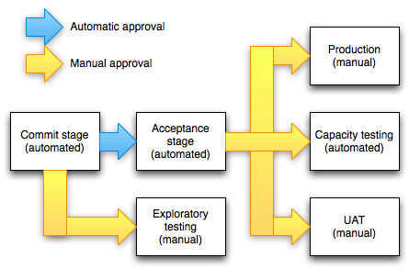
Better practices
http://continuousdelivery.com/2010/09/deployment-pipeline-anti-patterns/

Slide 15
gocd
Created in 2008 by Jez Humble
Open Source since 2014

Slide 16
Pipelines in GoCD
Pipelines are a first class concept in Go.
Stages: Run sequentially
Jobs: Run in parallel
Tasks: Run sequentially
Build Pipeline
Compile Software
Unit Test
Package

Slide 17
GoCD Configuration options
Graphical User Interface
Original Interface
New “one page app”
Internal Git Repository
Configuration as Code
External YAML Repository
External JSON Repository
And more…

Slide 18
Set up for today’s workshop
You should have an IP address. That address is the server which will be hosting GoCD as well as the “hello world” application we are deploying.
GoCD – Port 8153
Application
Production – 3000
Staging – 3001
User Acceptance – 3002
Functional Test – 3003

Slide 19
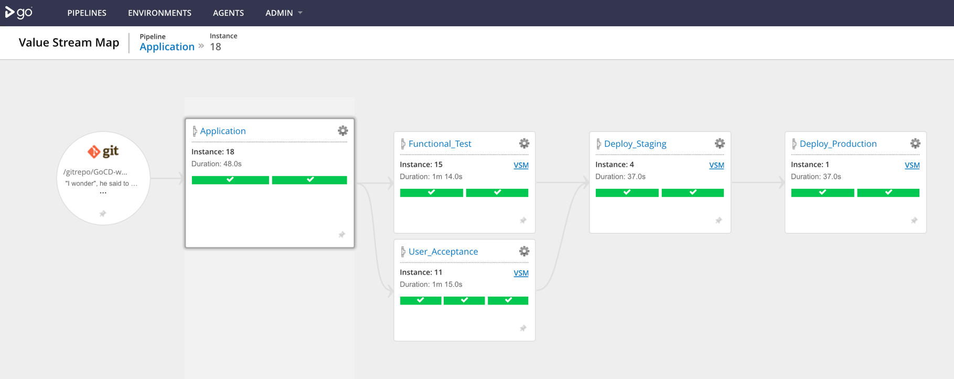

Slide 20
Sign in to GitHub
( Accounts are free if you need to create one)

Slide 21
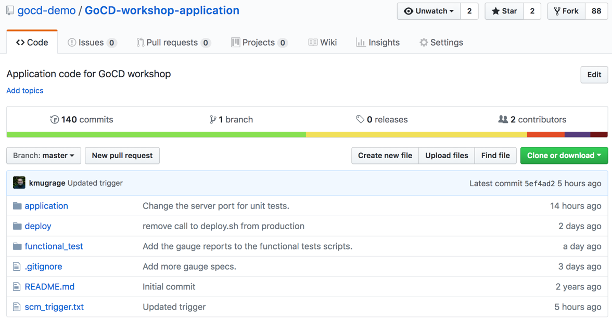
Fork application code repository
https://github.com/gocd-demo/GoCD-workshop-application

Slide 22
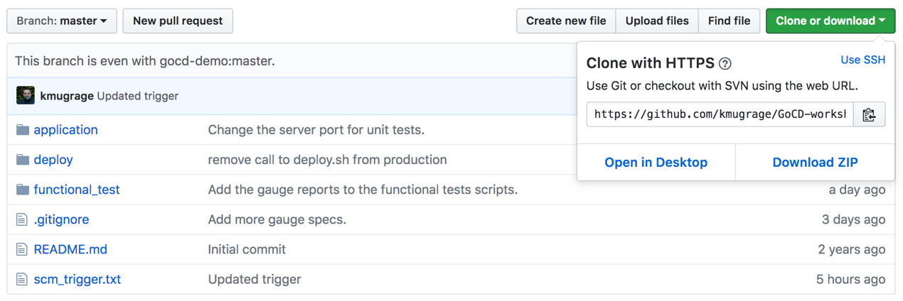
Copy the https URL for your Git repository

Slide 23
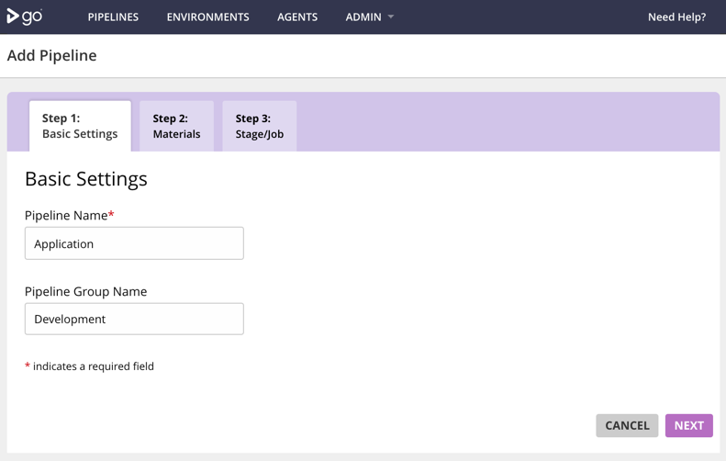
http://[your_IP]:8153/

Slide 24
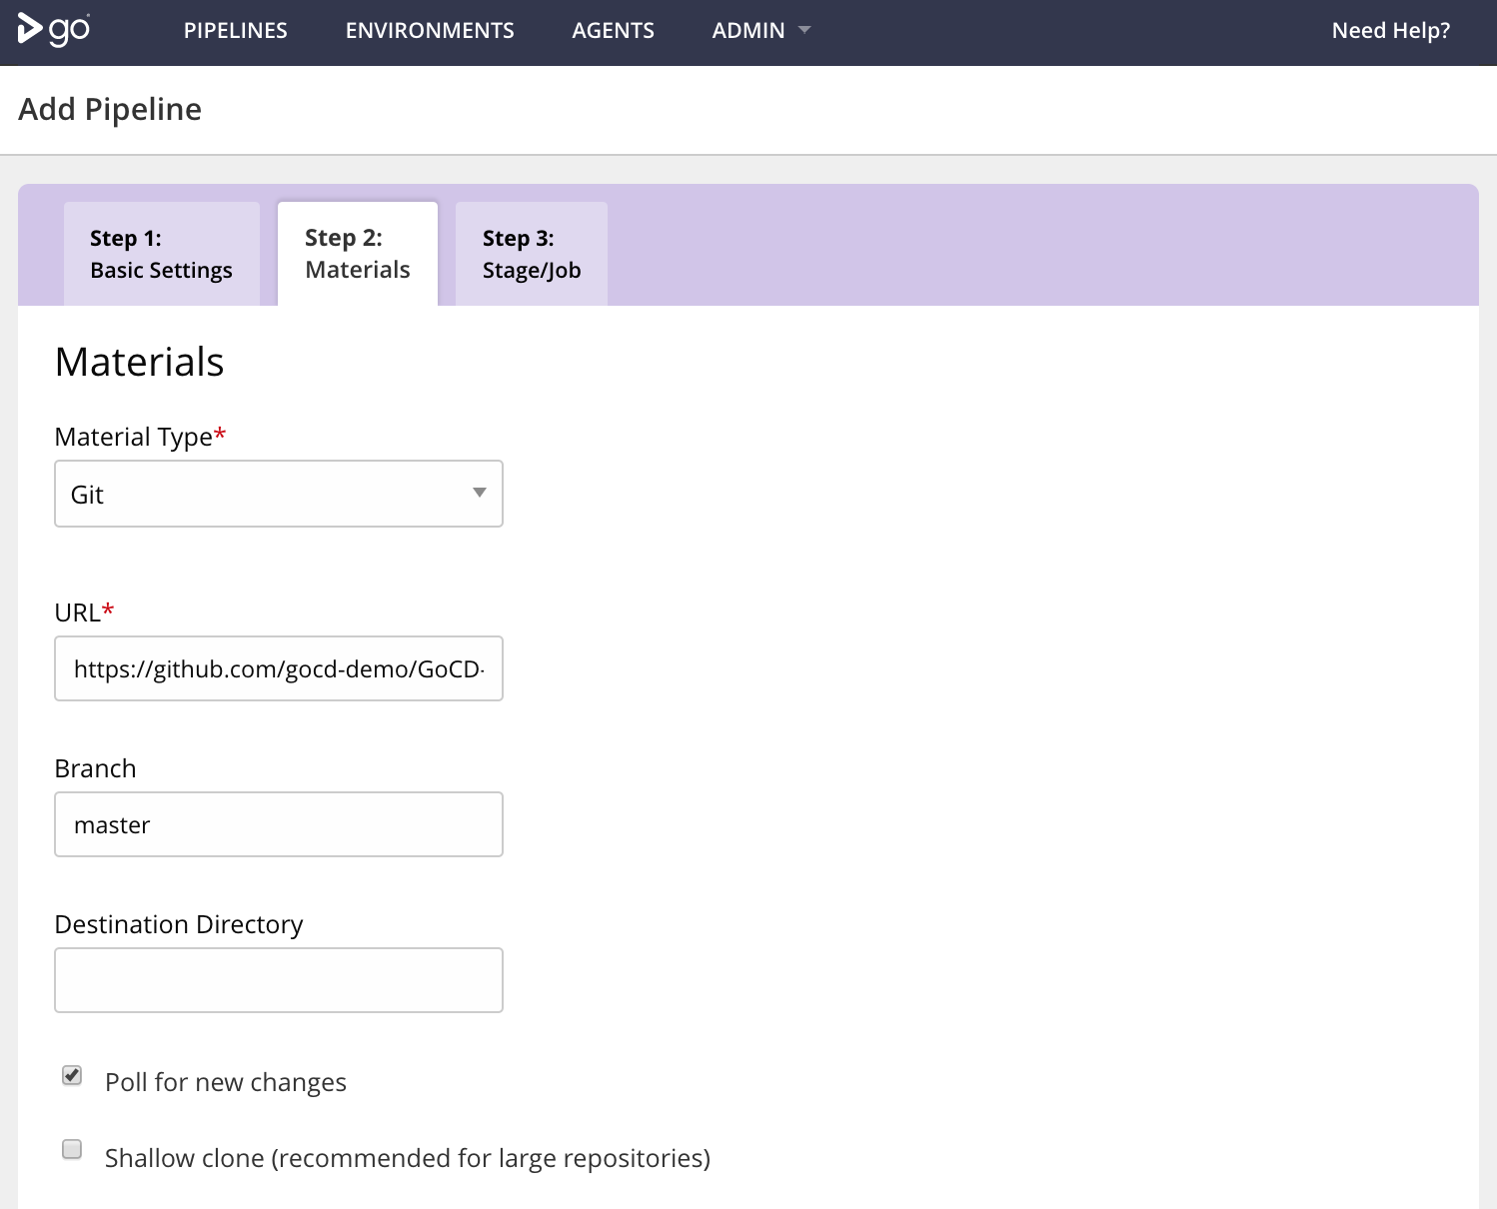

Slide 25
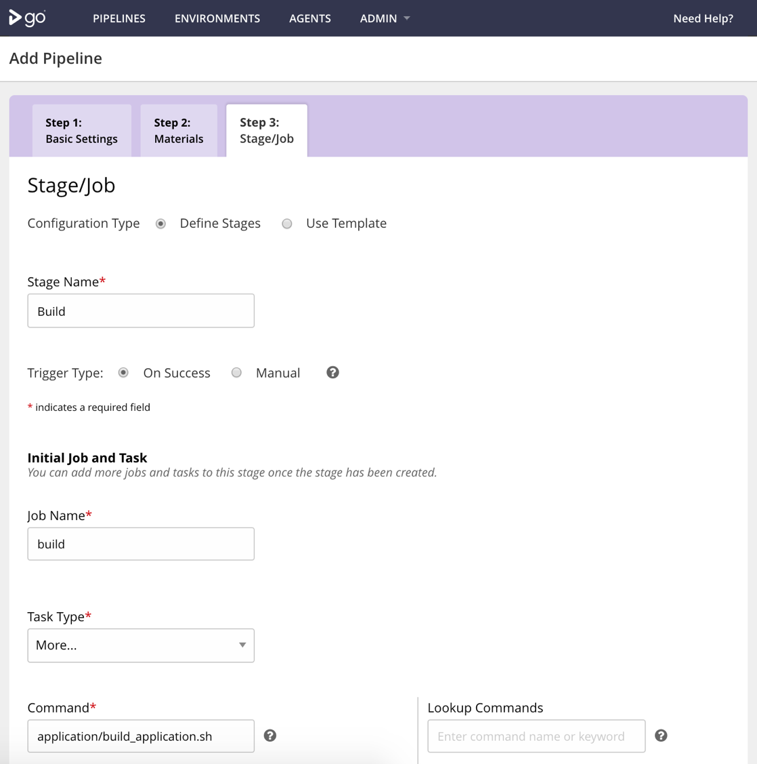

Slide 26
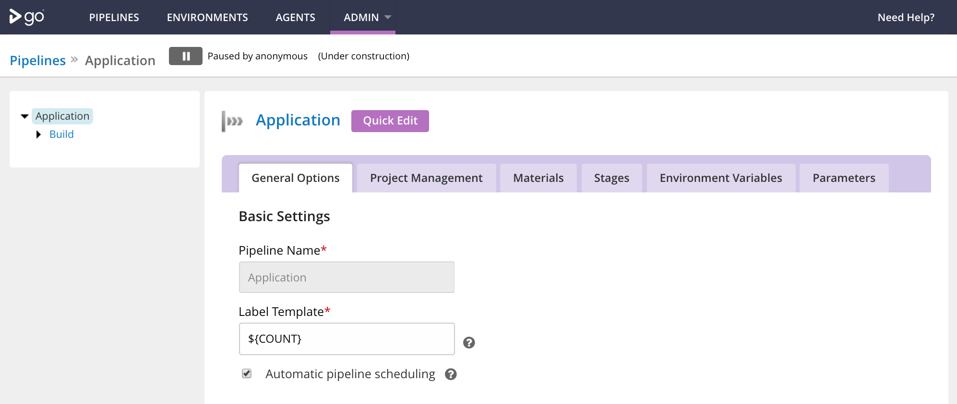

Slide 27
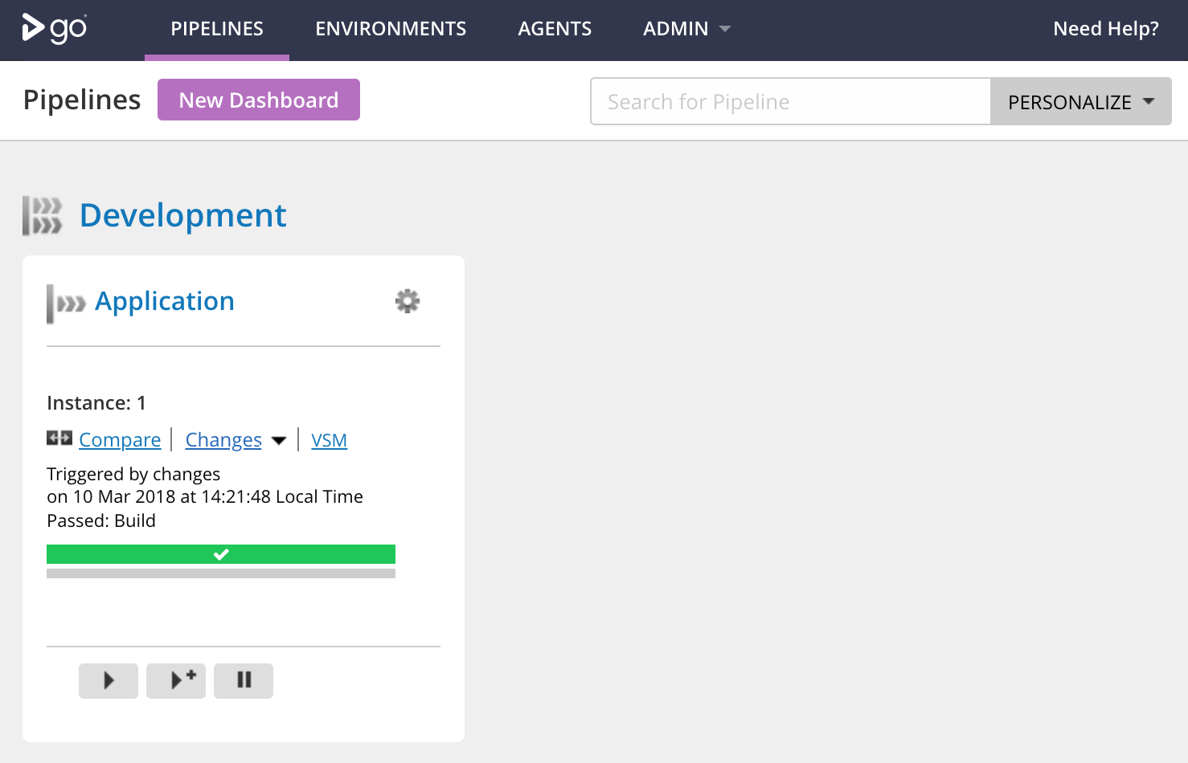

Slide 28
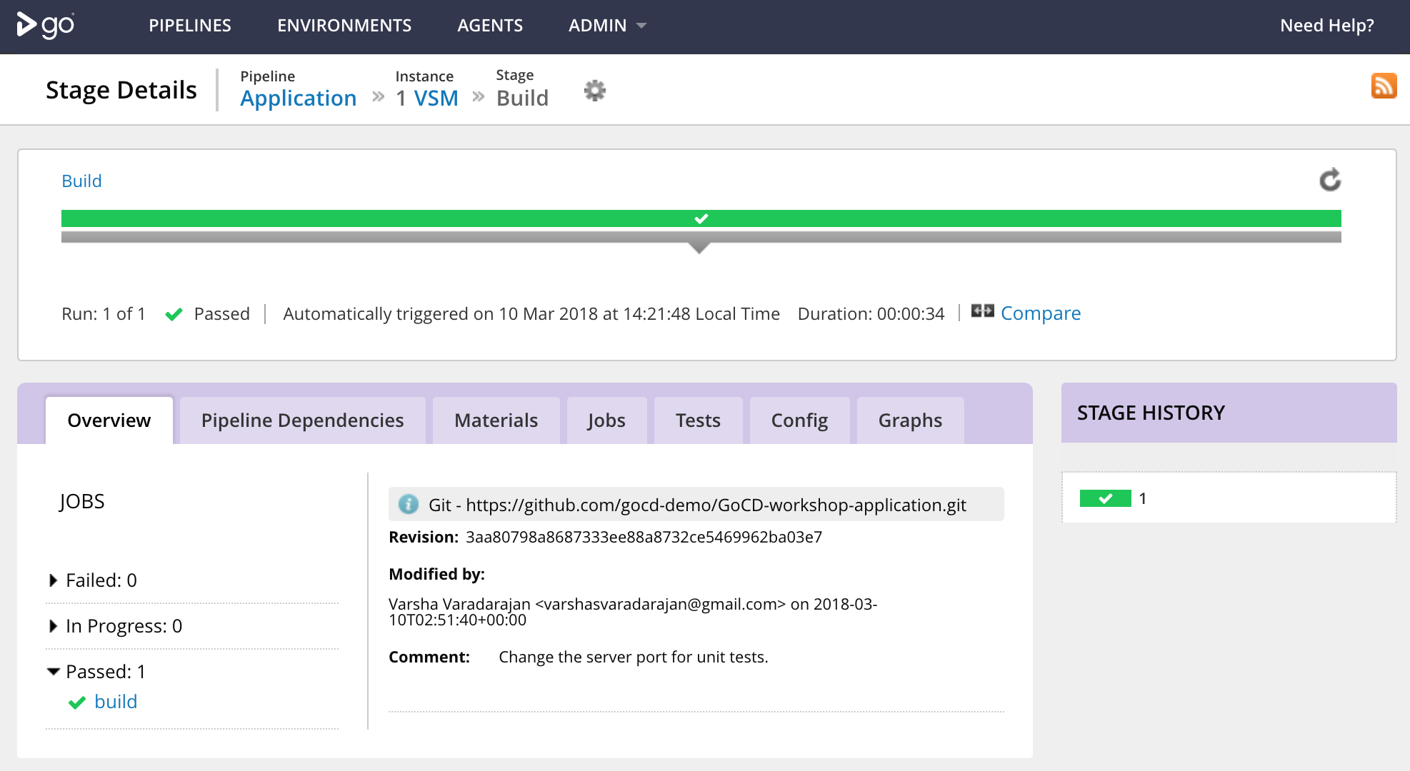

Slide 29
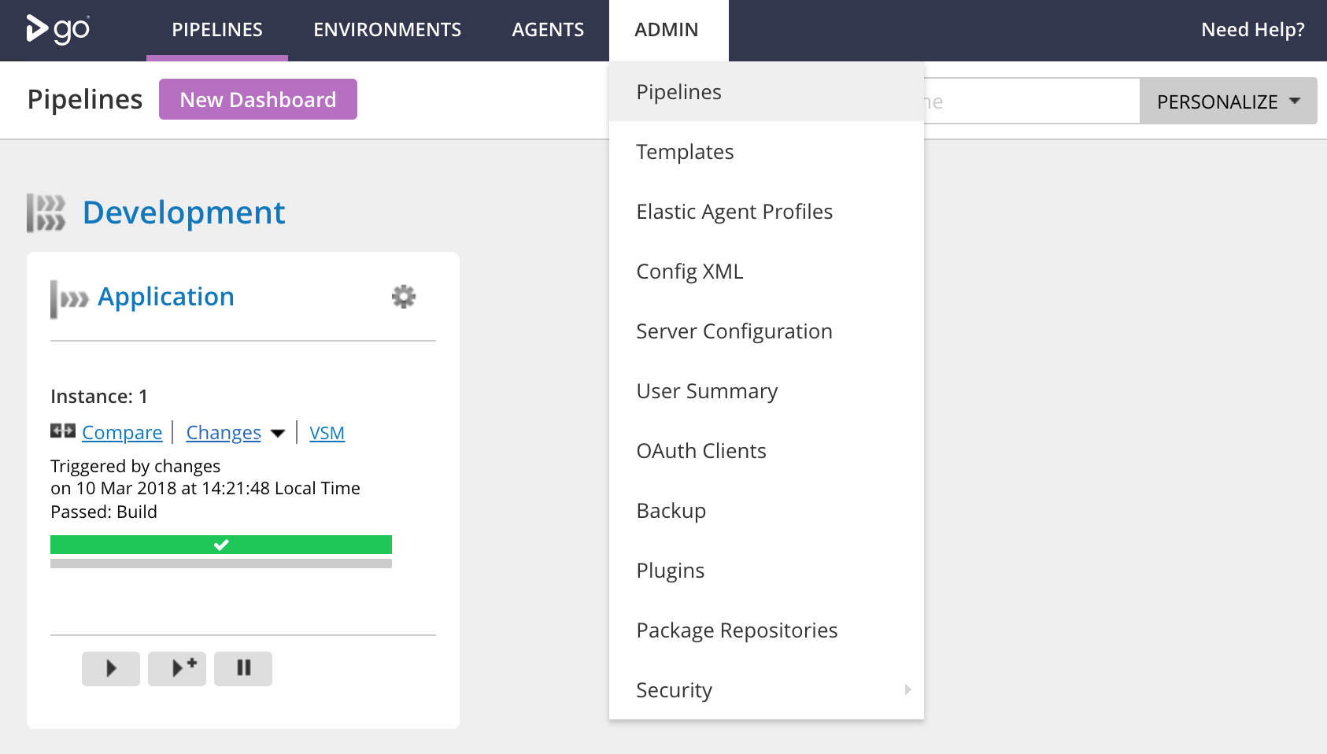

Slide 30
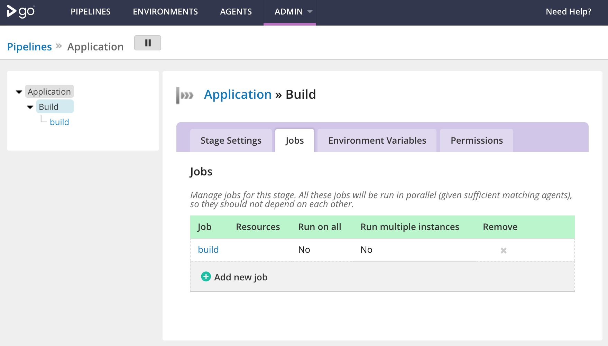

Slide 31
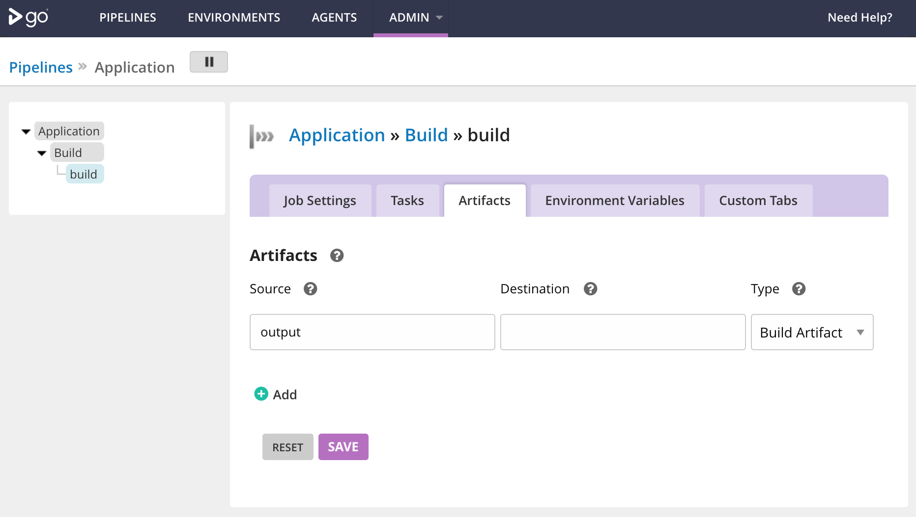

Slide 32
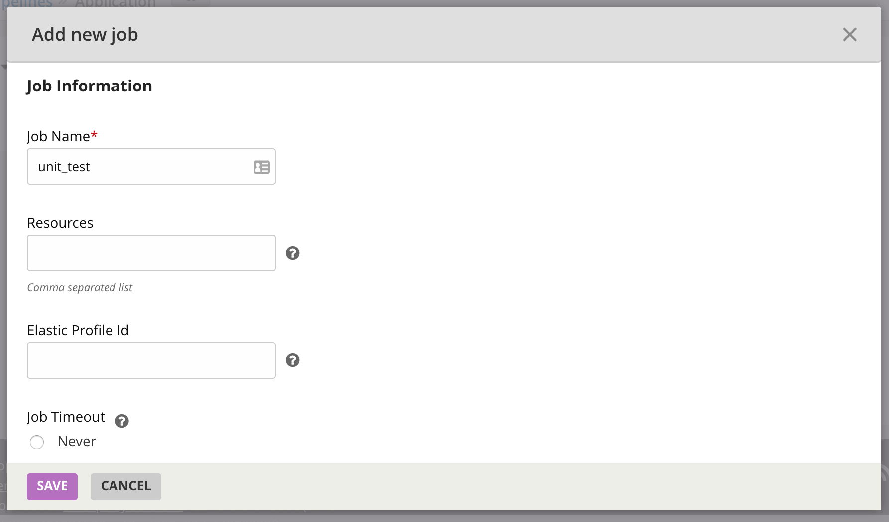

Slide 33
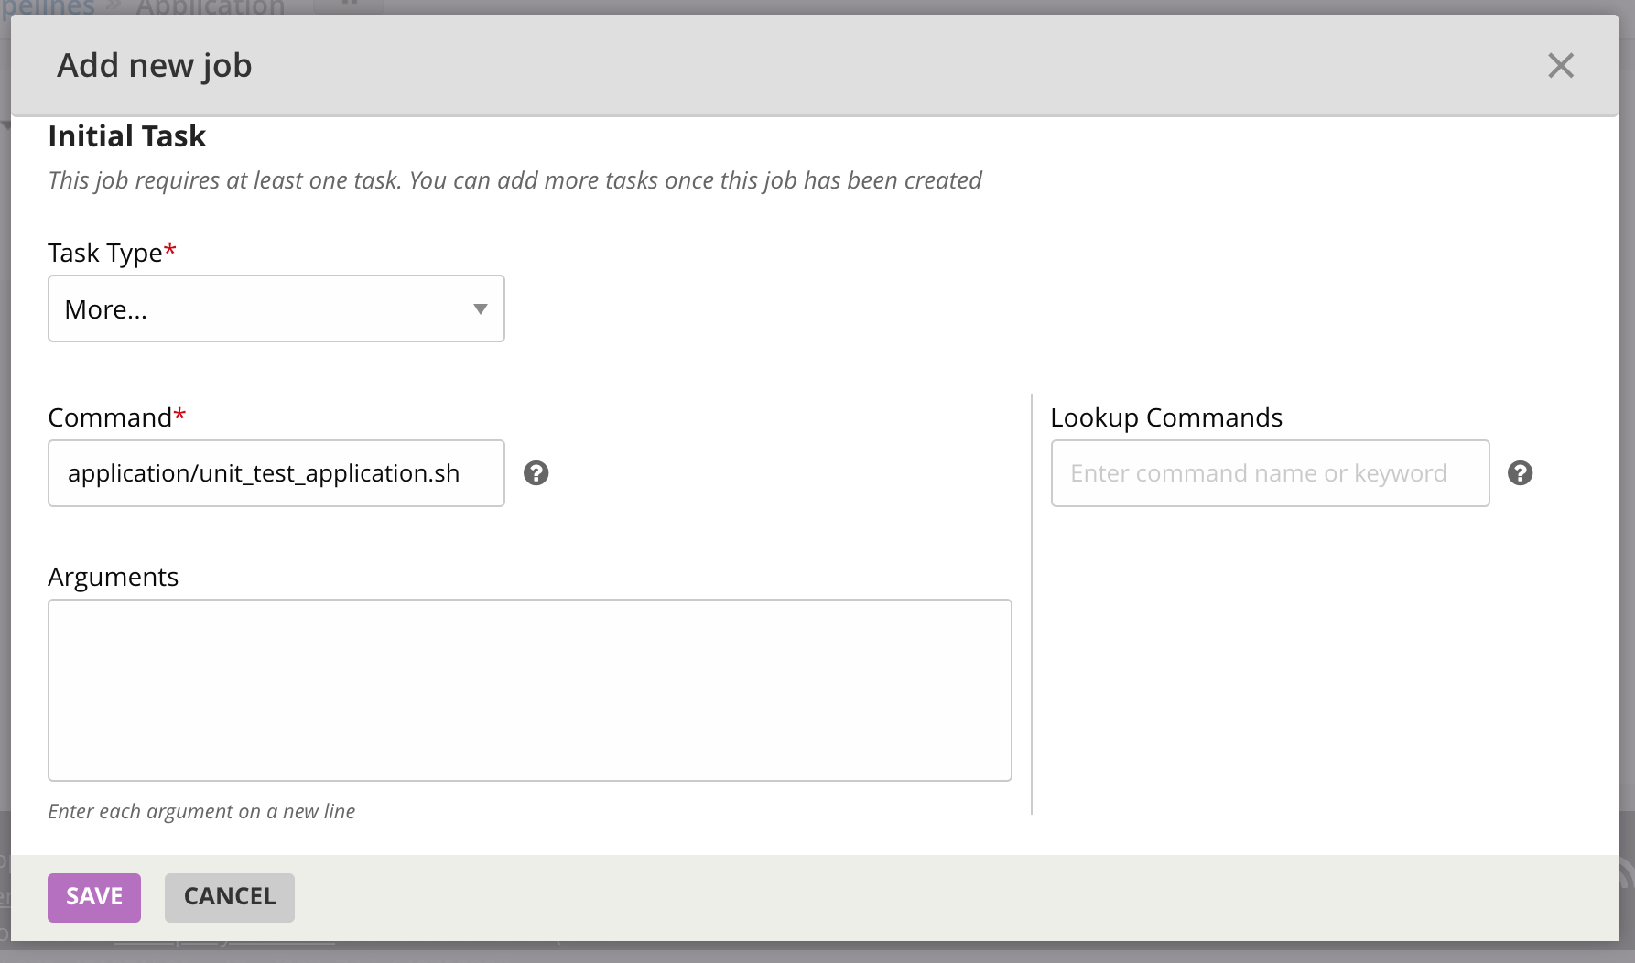

Slide 34
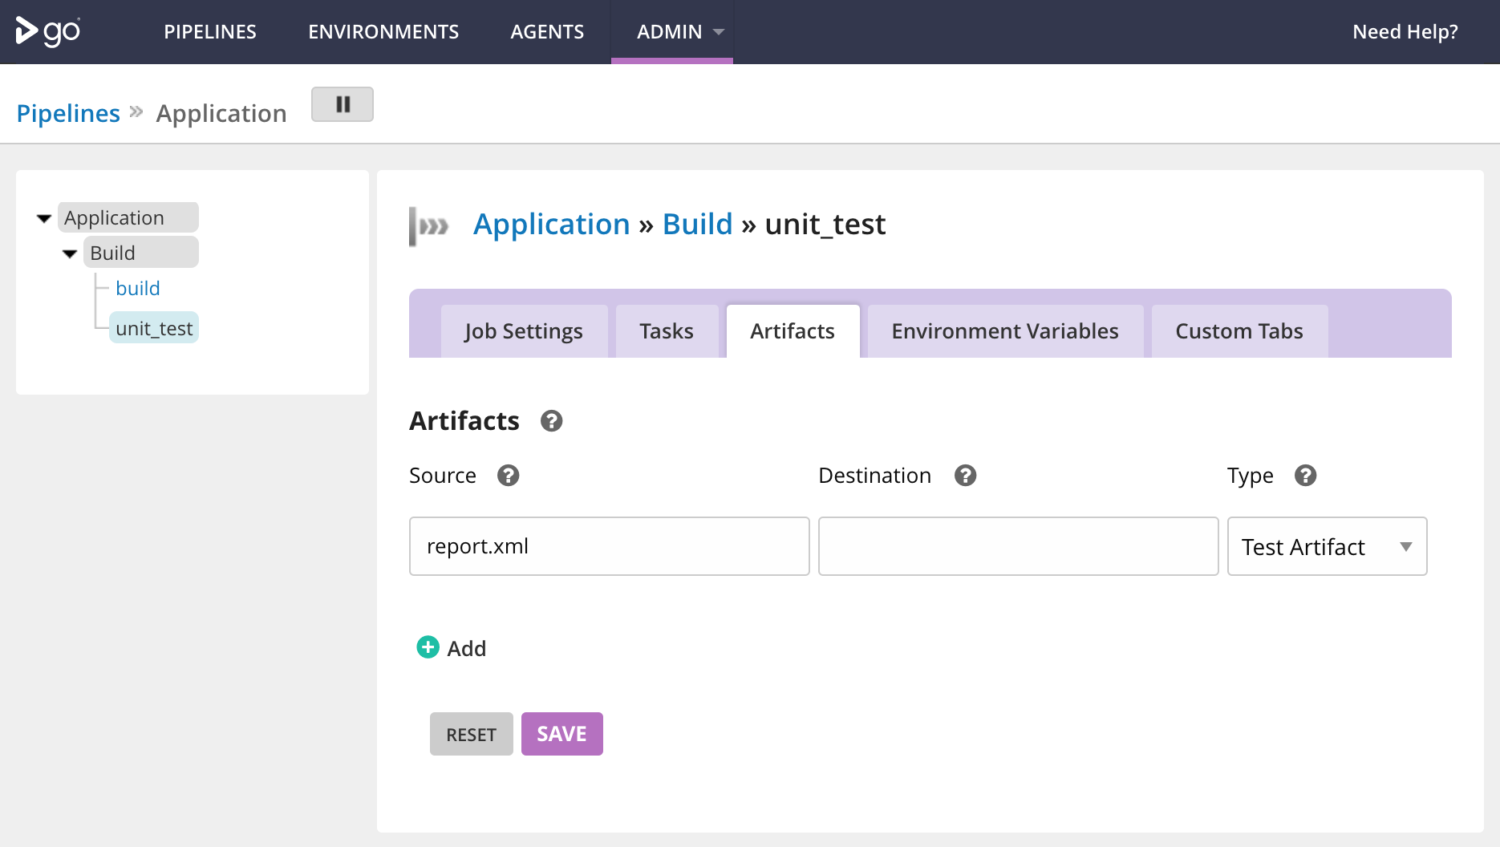

Slide 35
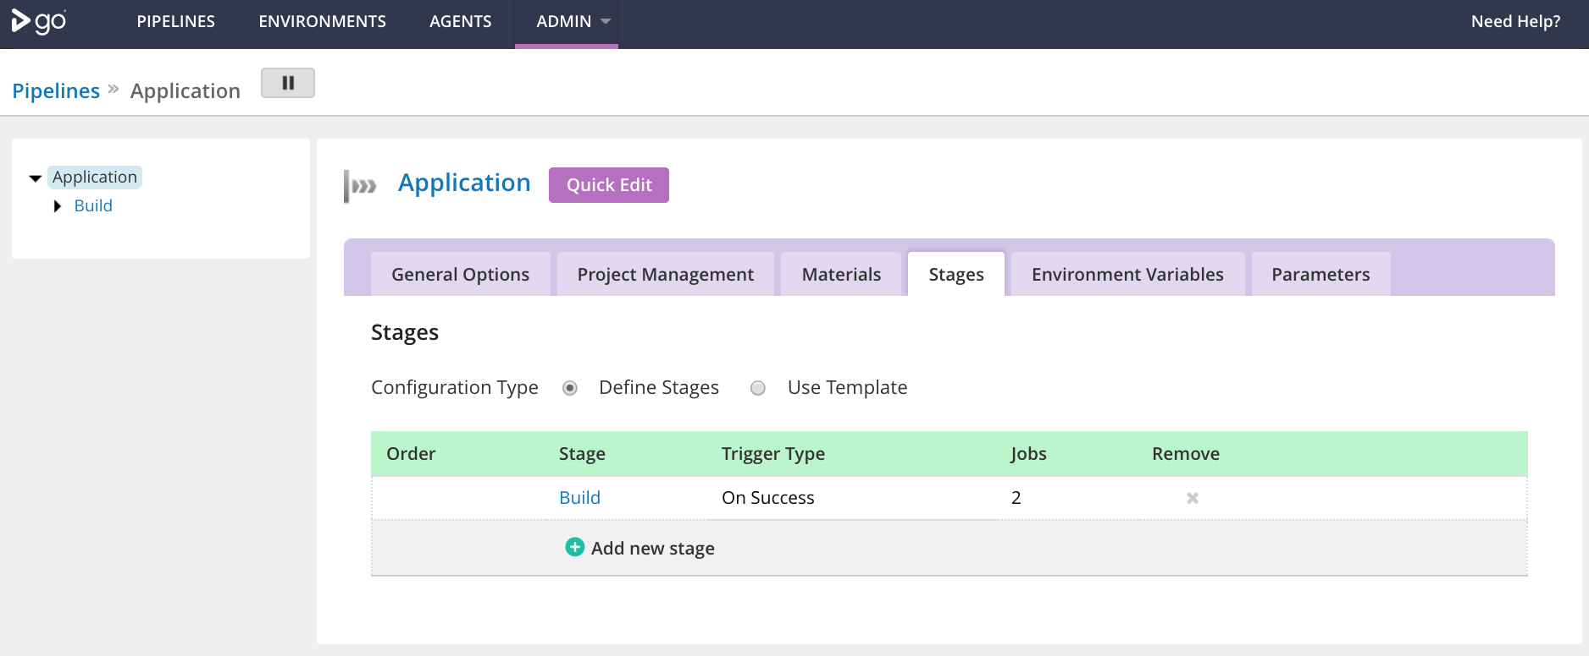

Slide 36
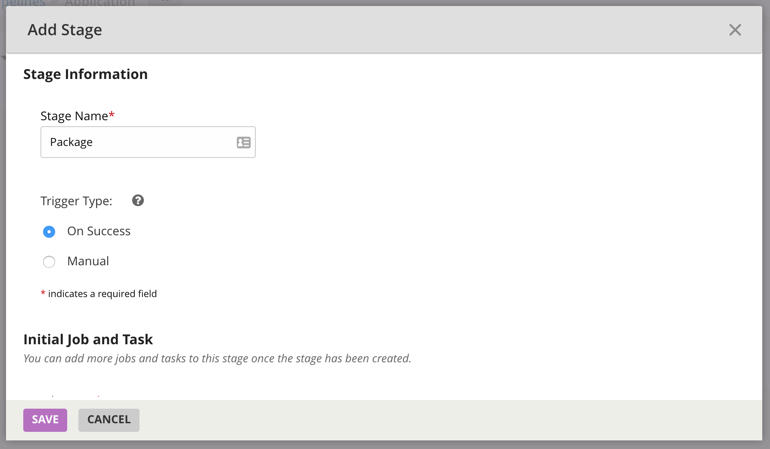

Slide 37
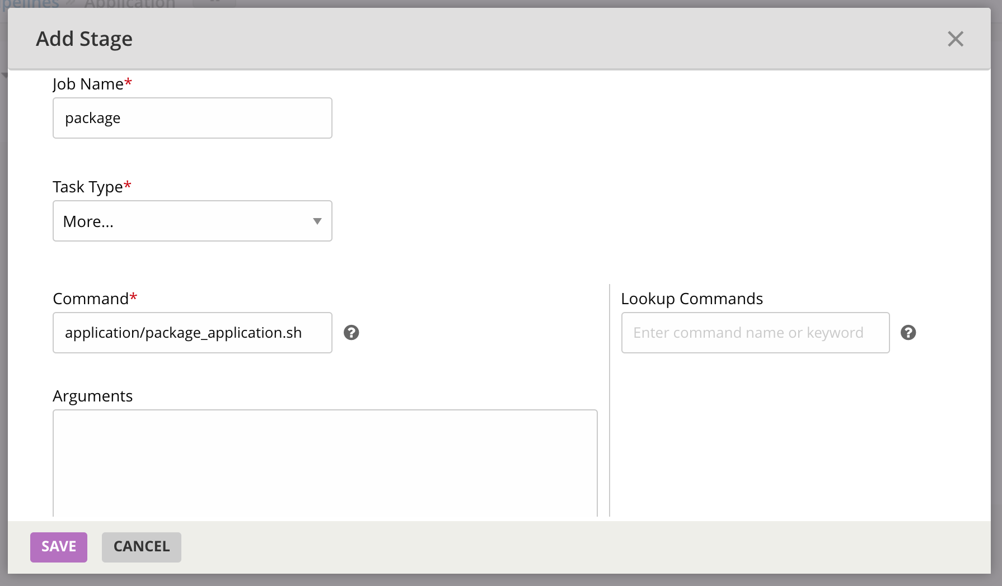

Slide 38
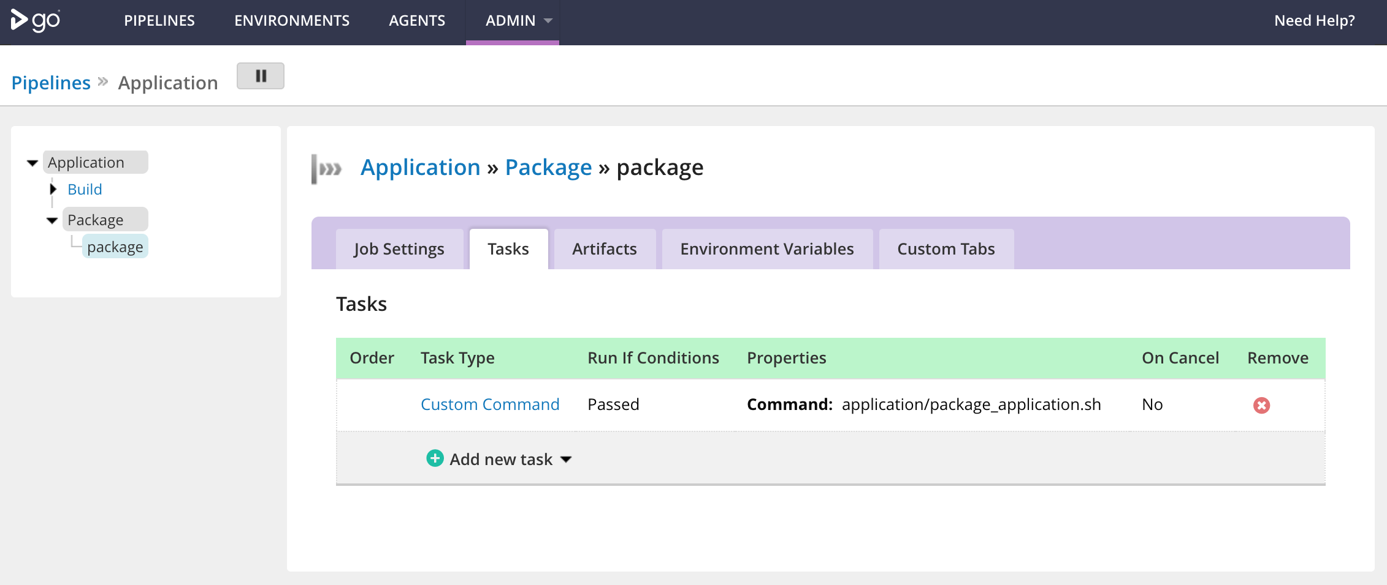

Slide 39
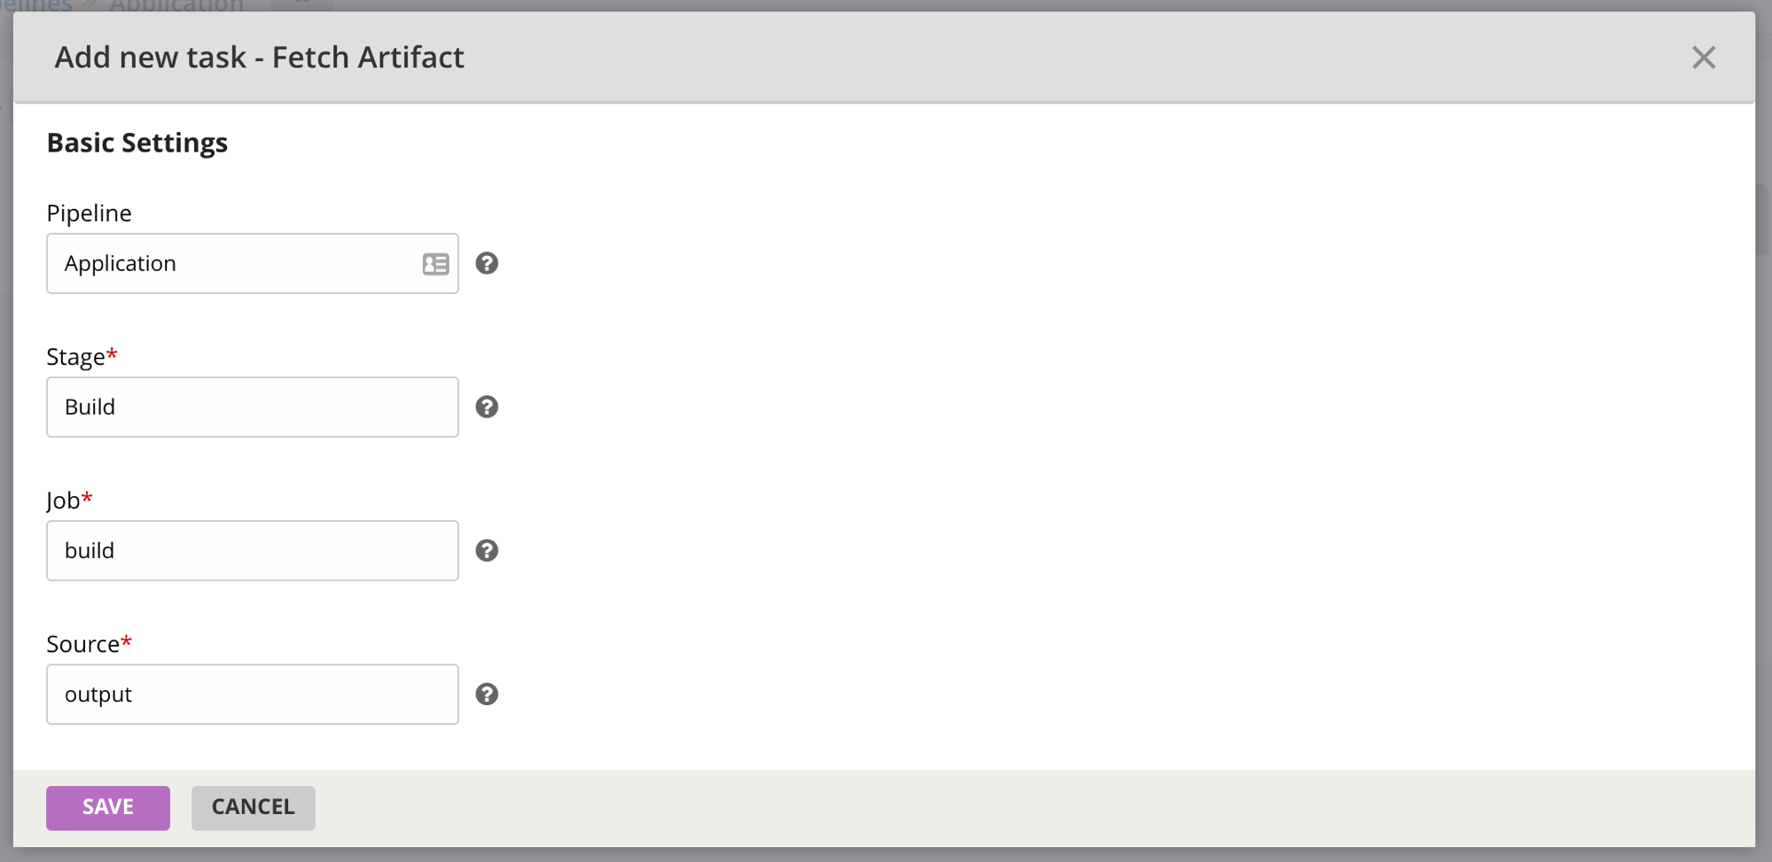

Slide 40
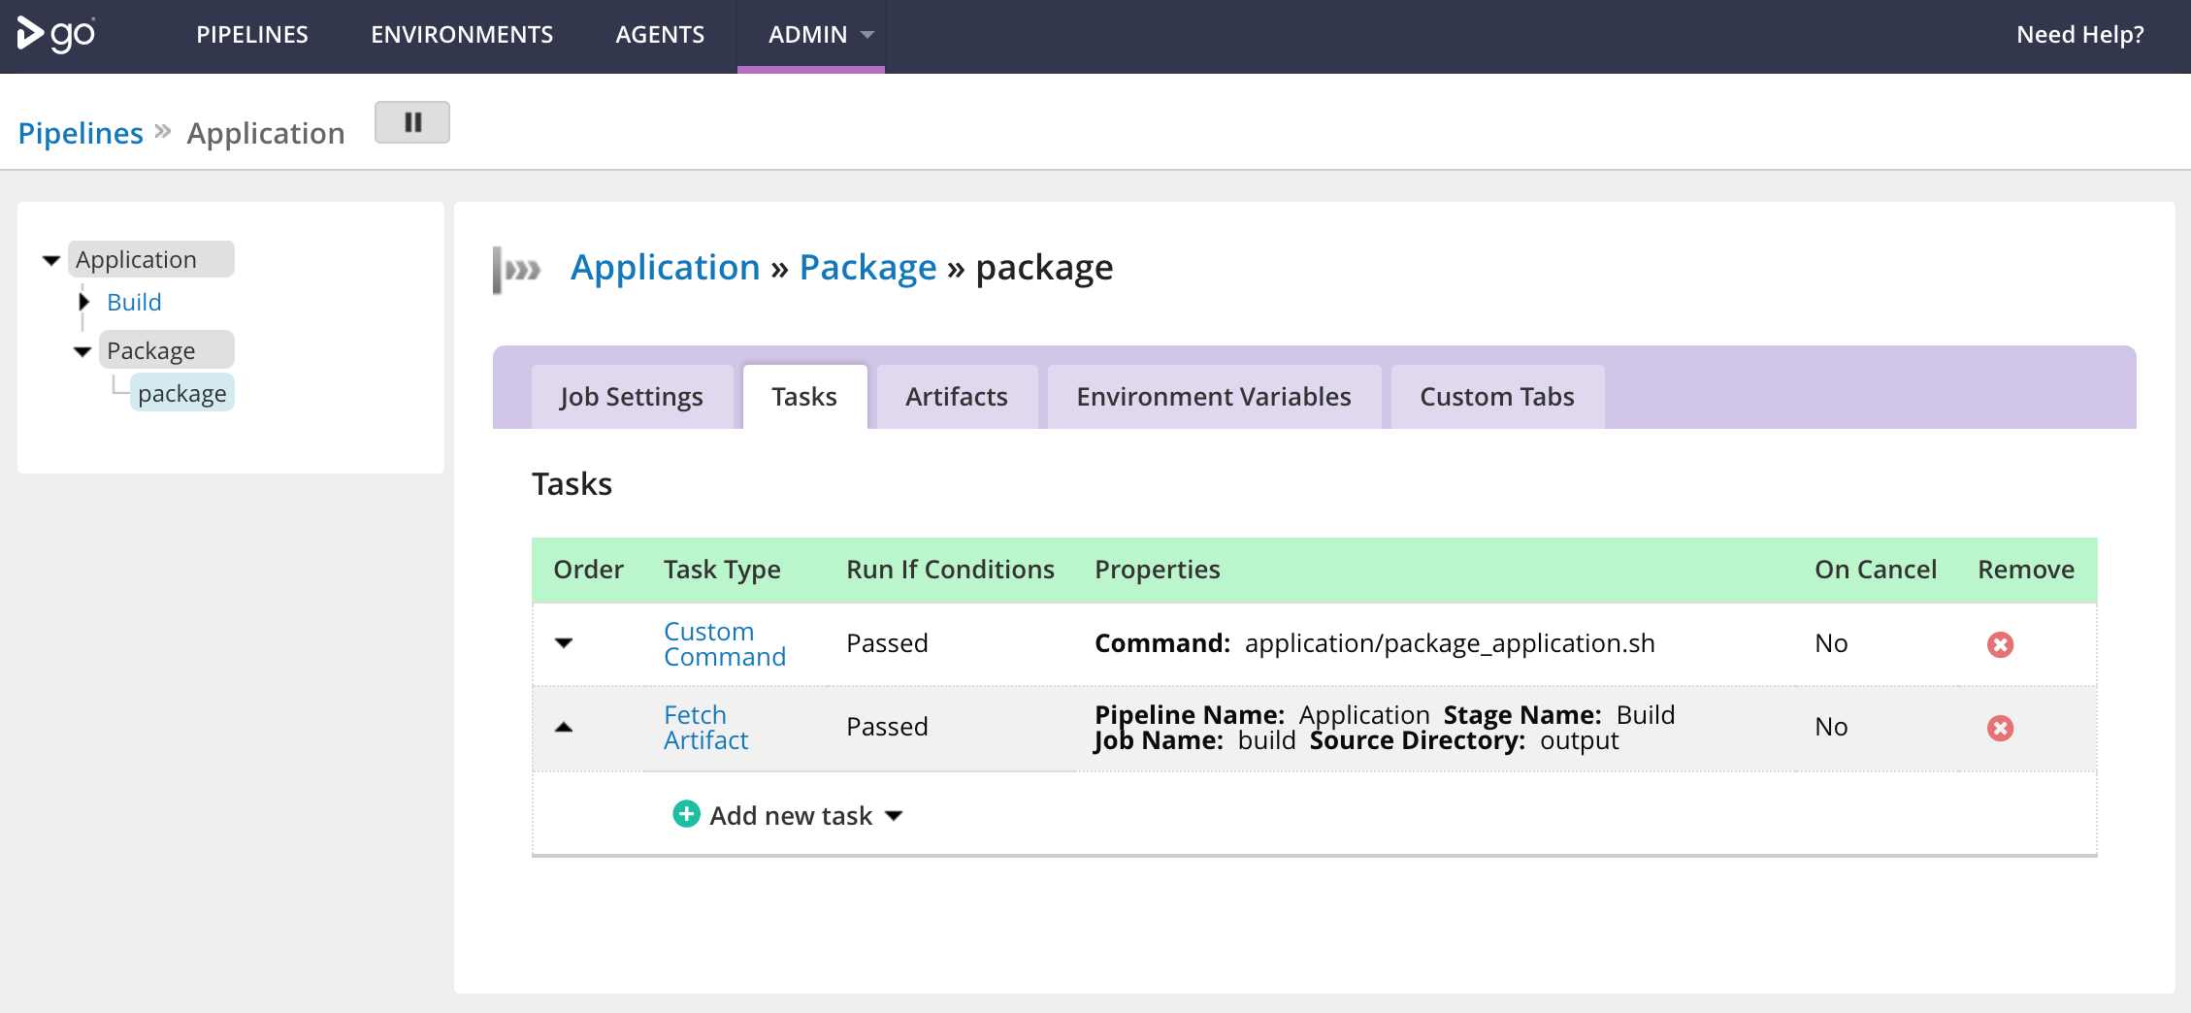

Slide 41
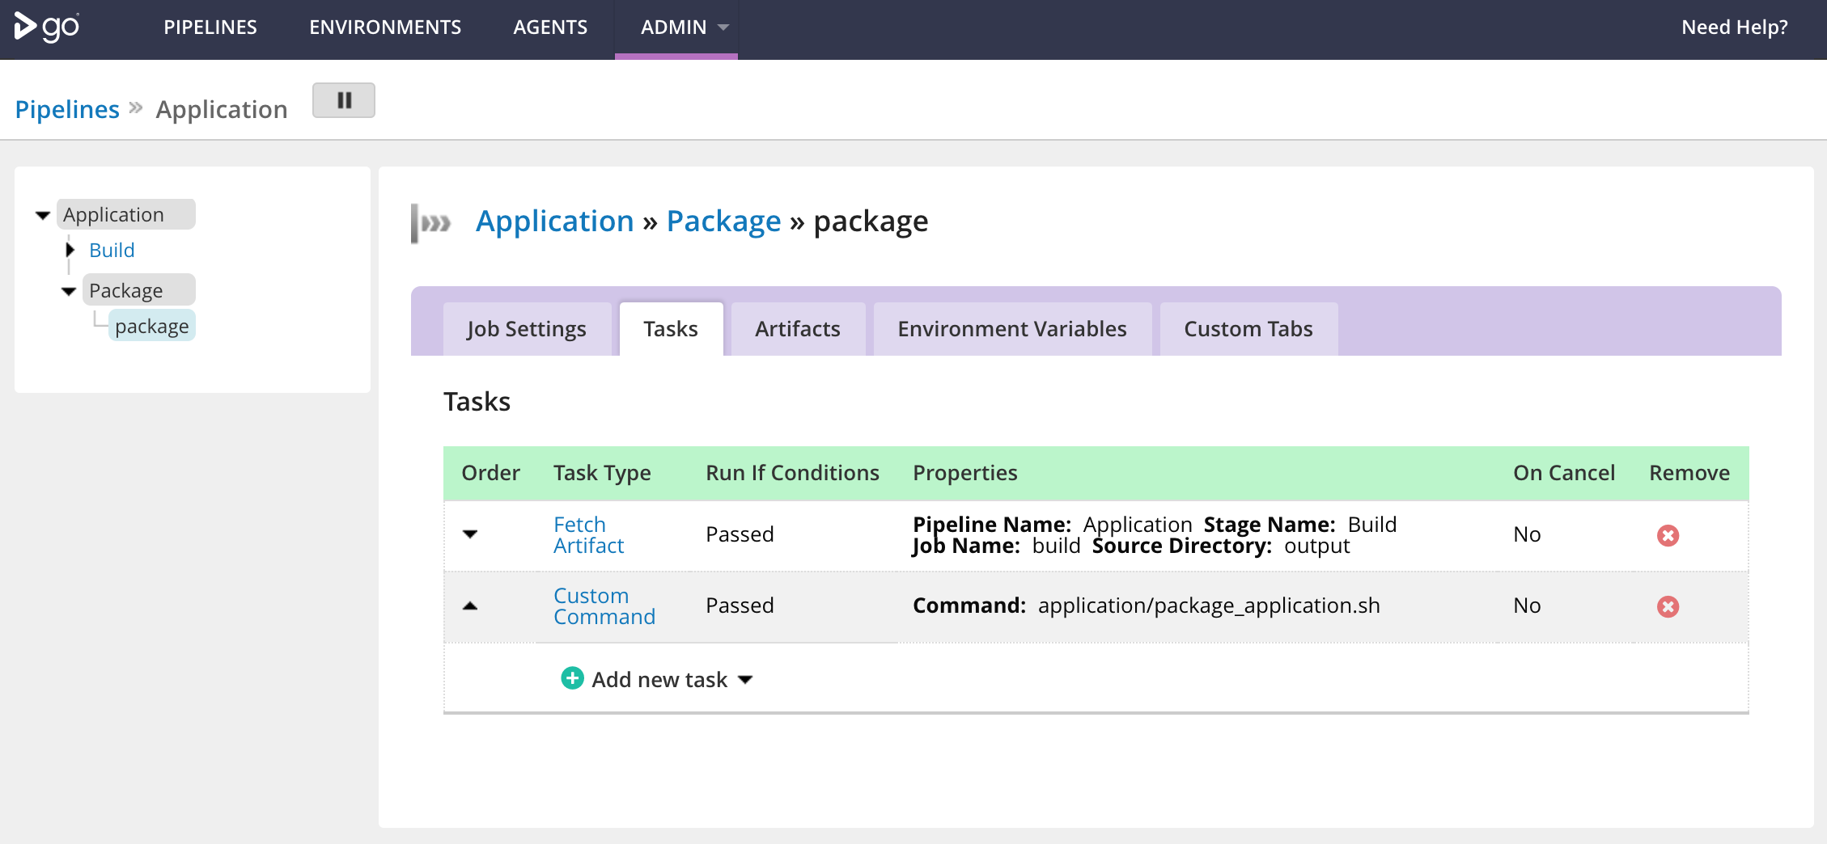

Slide 42
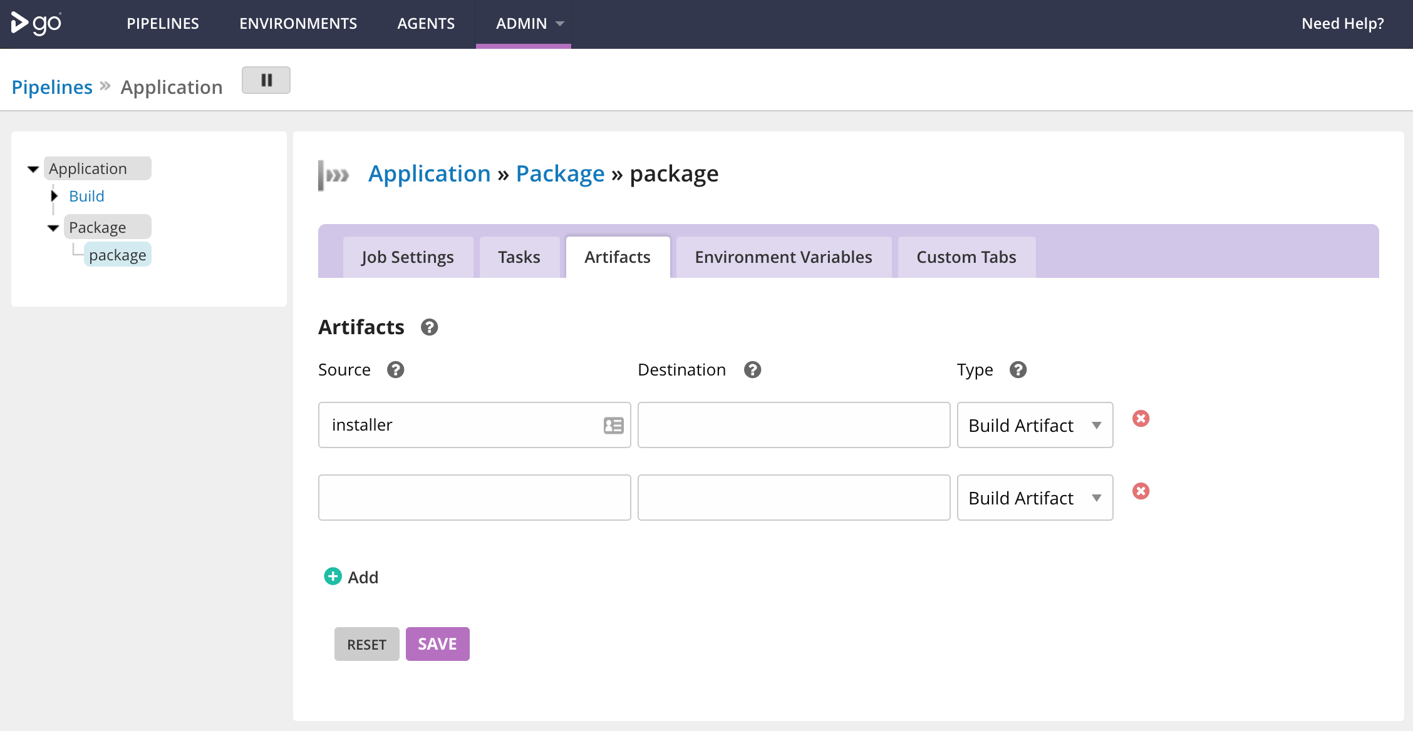

Slide 43
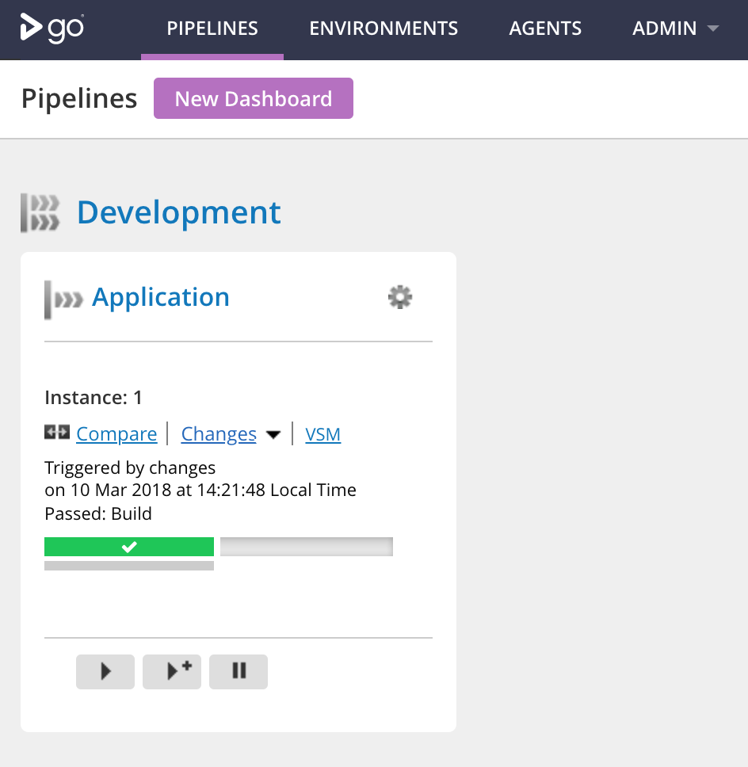

Slide 44
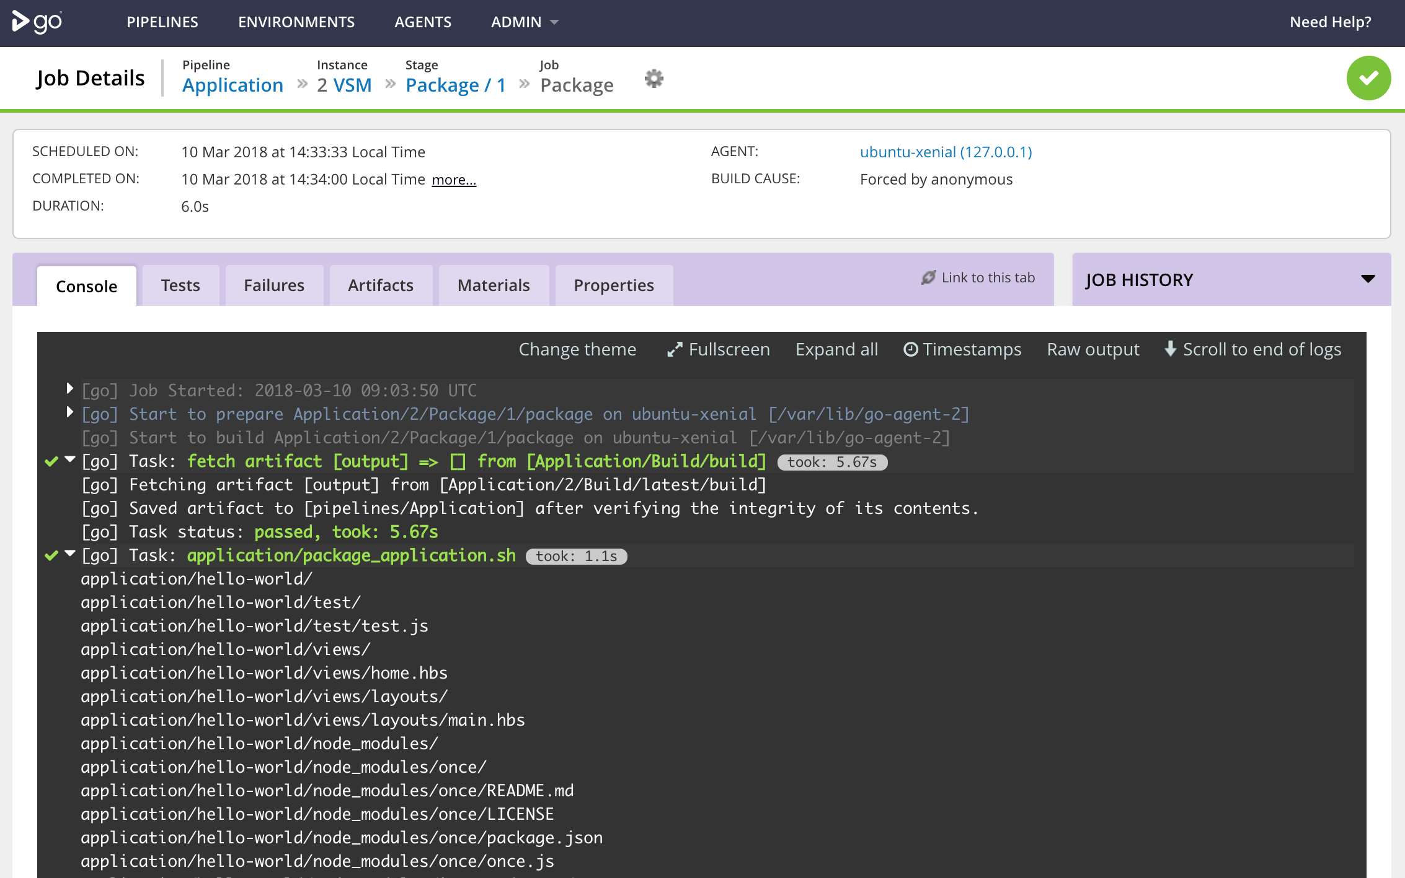

Slide 45
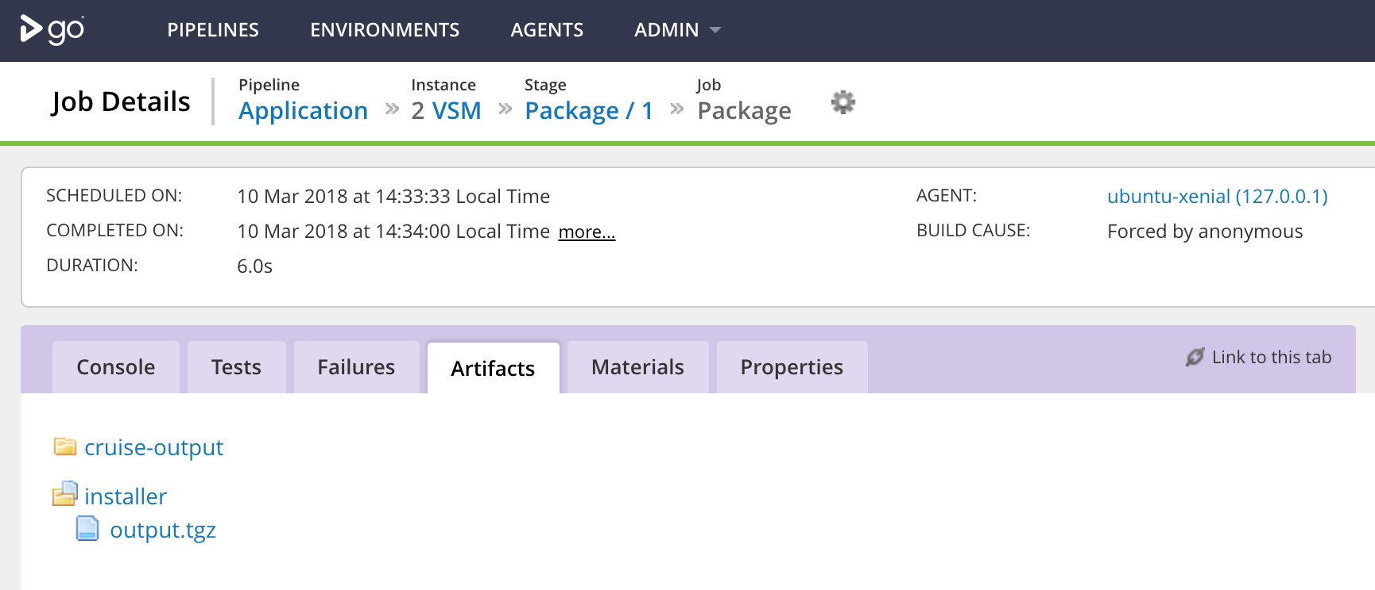

Slide 46
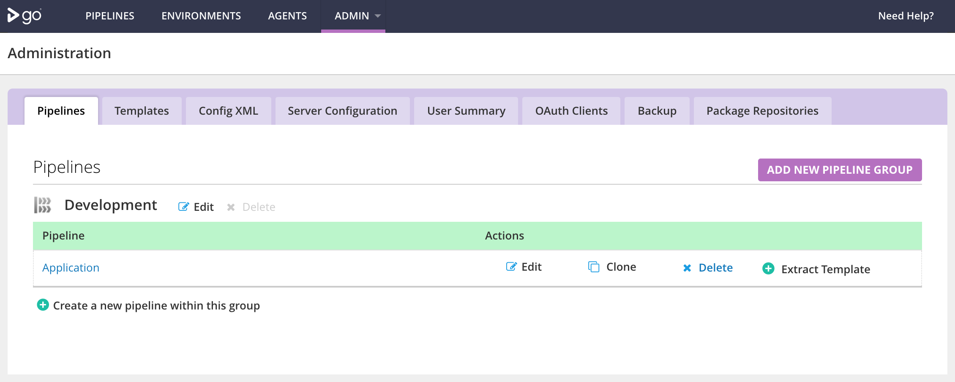

Slide 47
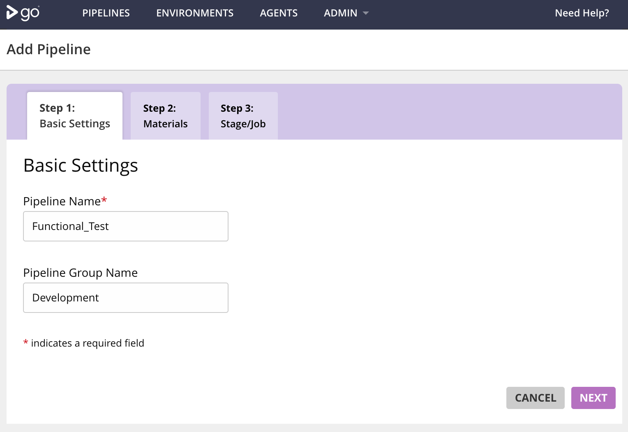

Slide 48
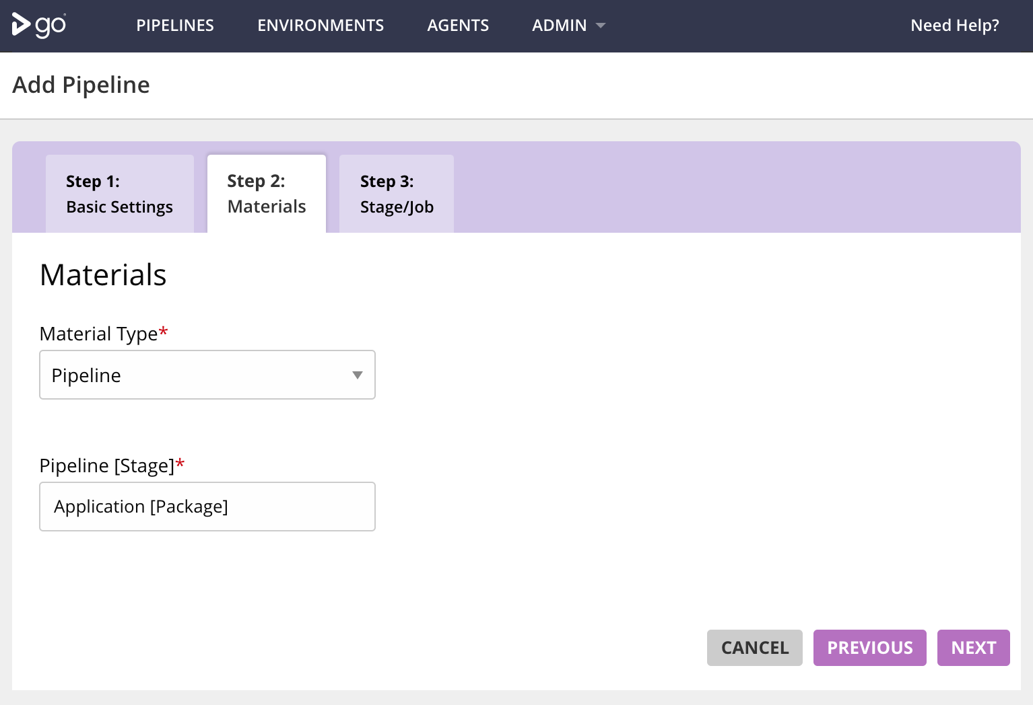

Slide 49
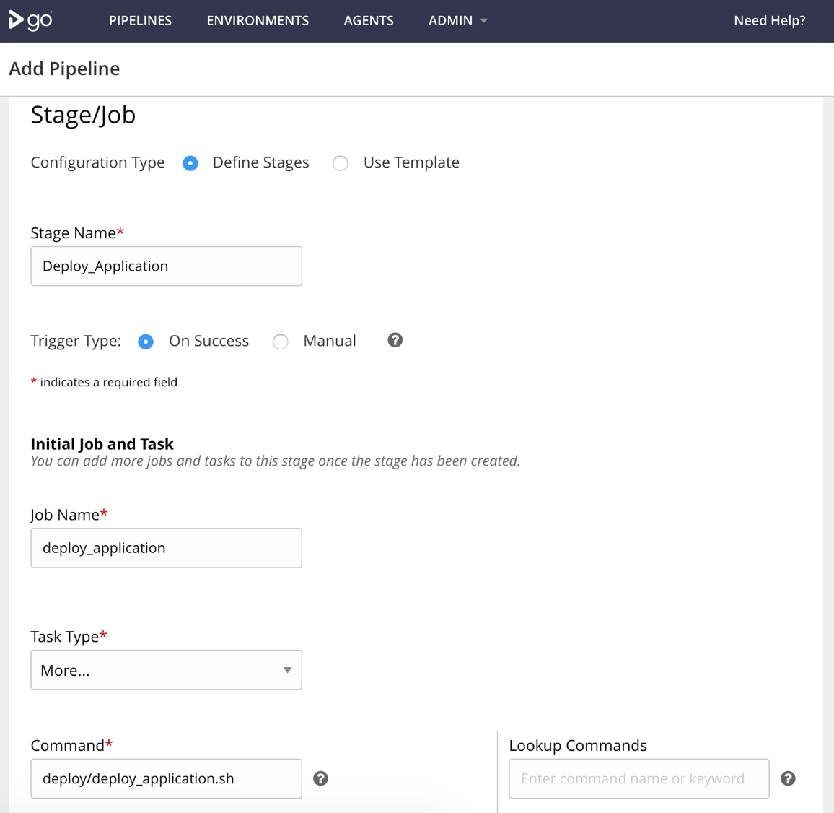

Slide 50
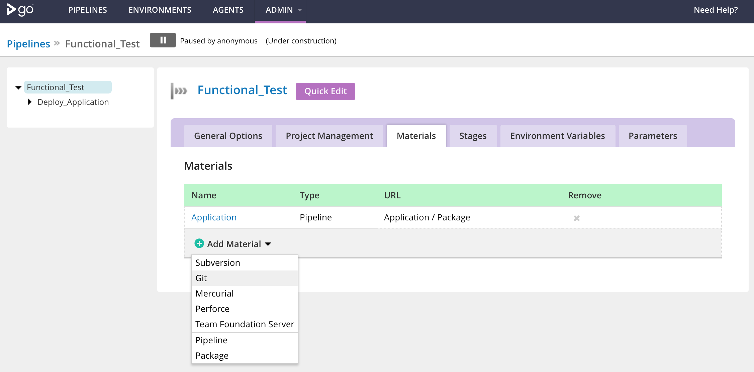

Slide 51
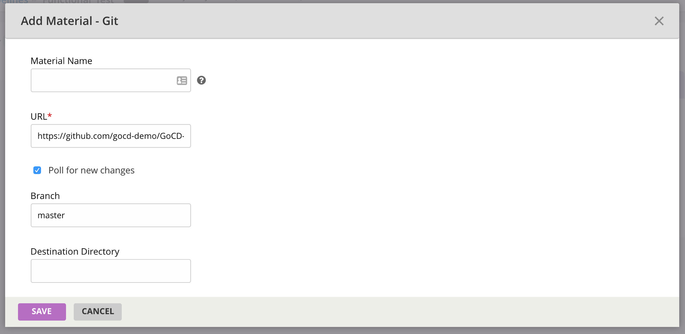

Slide 52
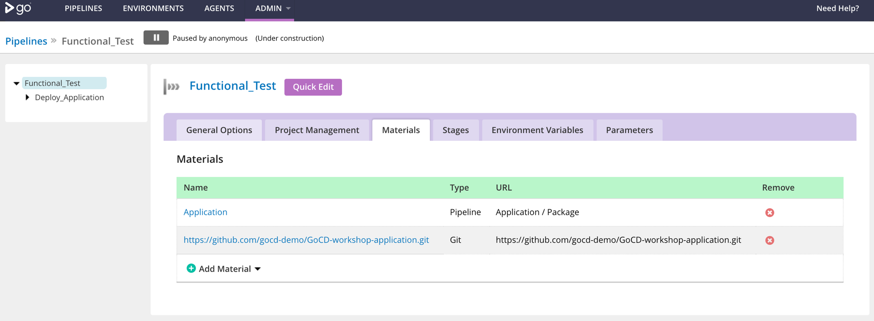

Slide 53
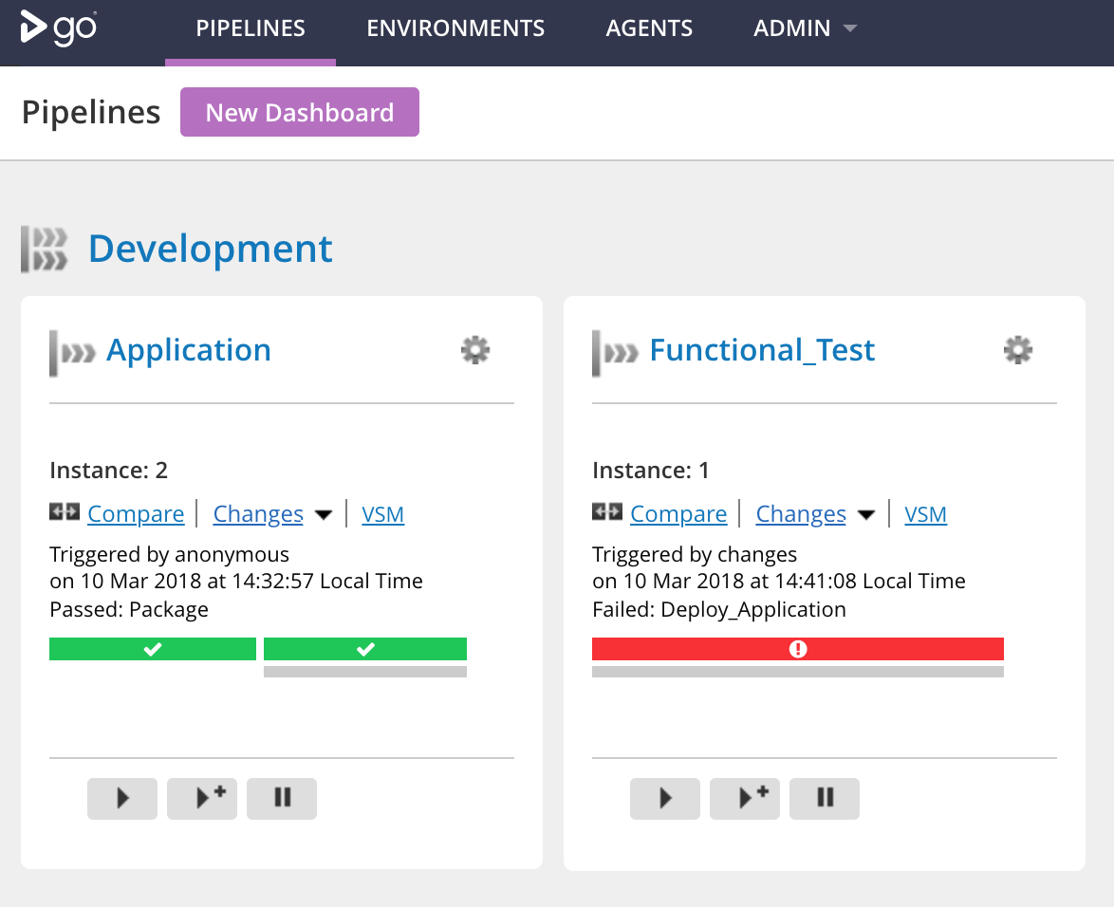

Slide 54
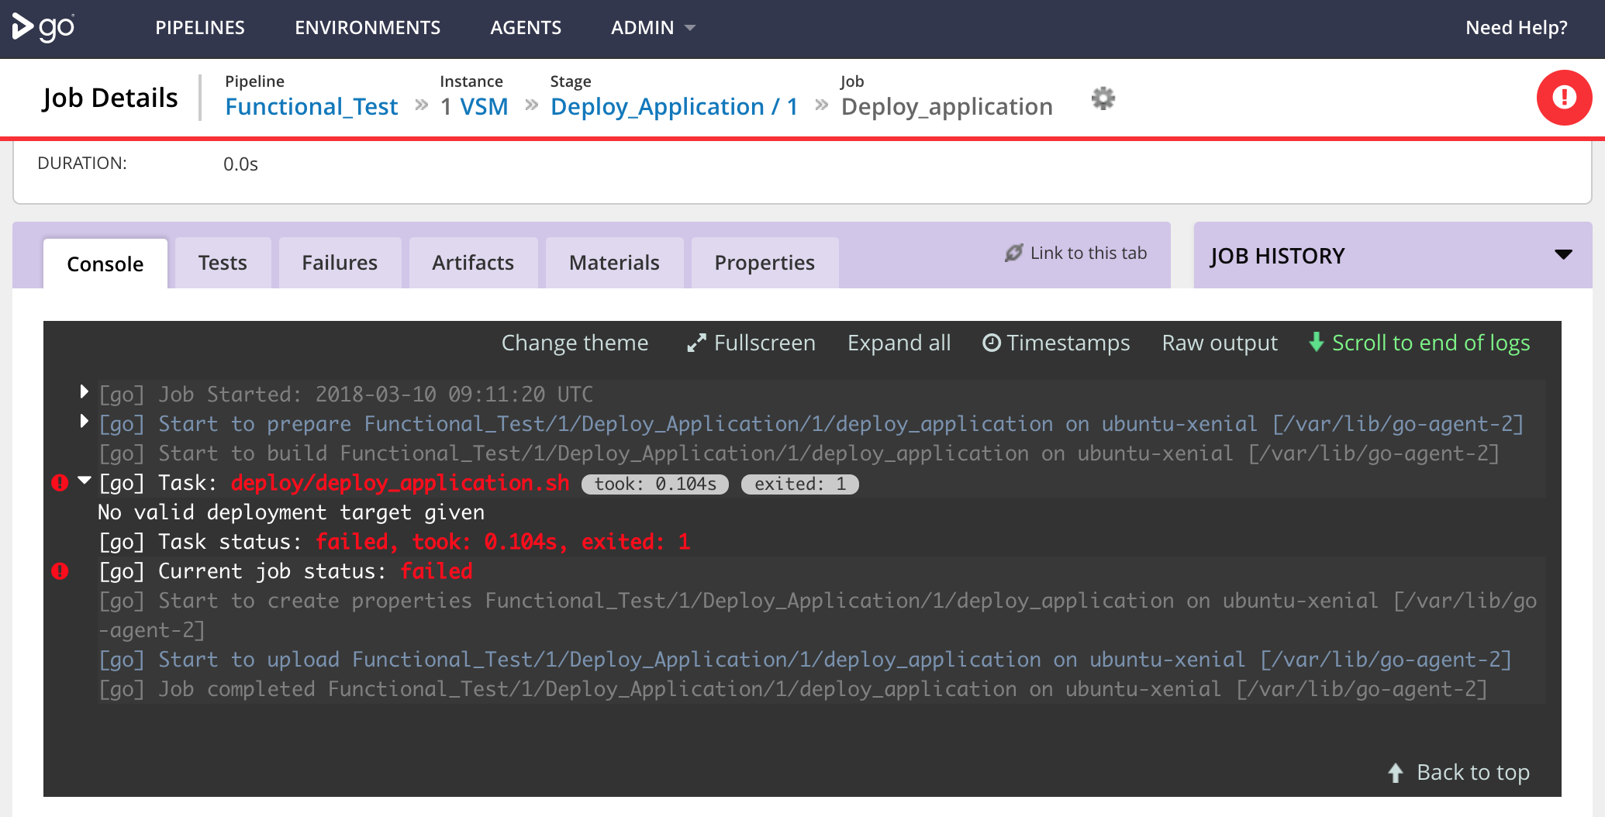

Slide 55
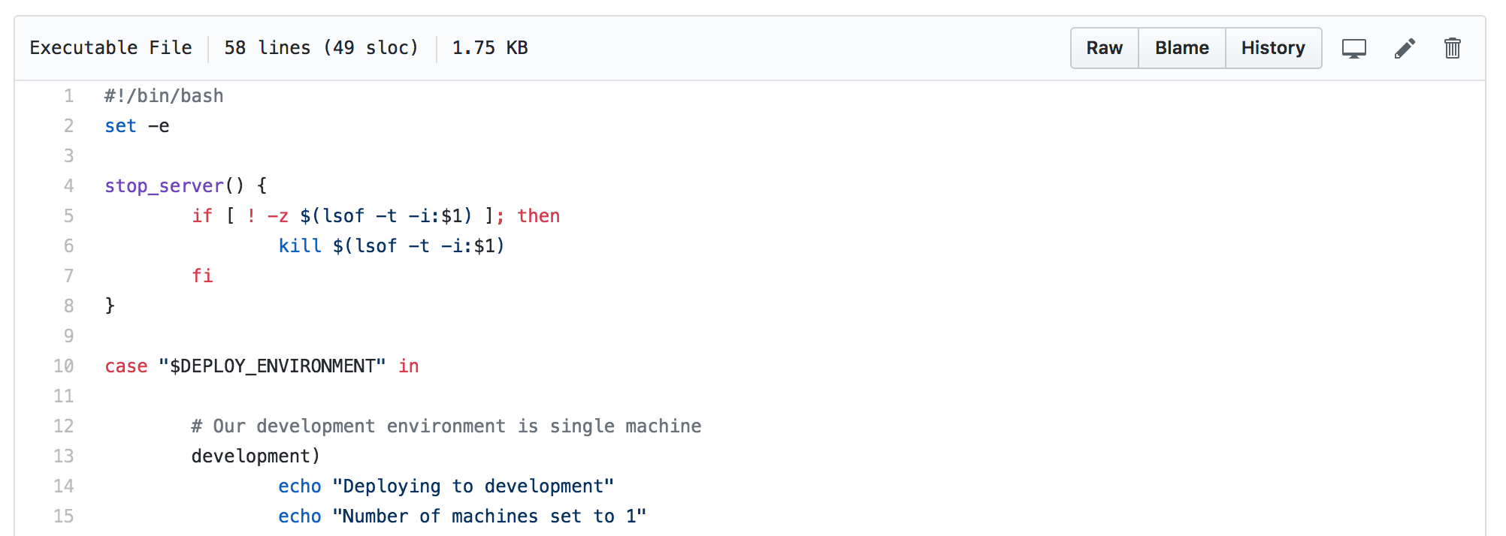

Slide 56
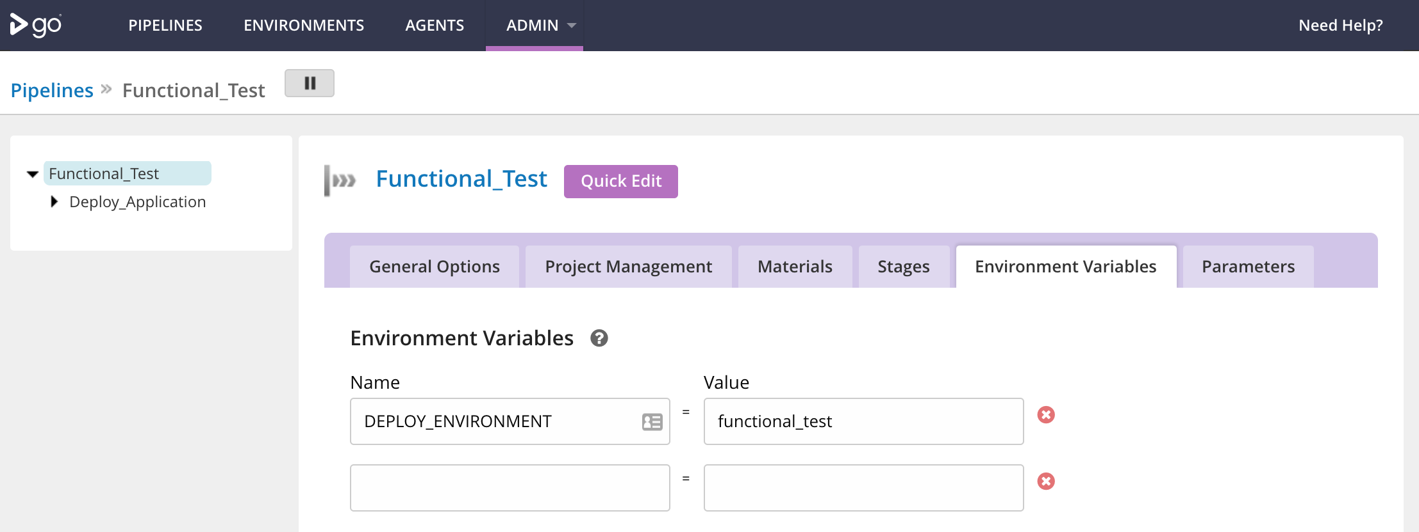

Slide 57
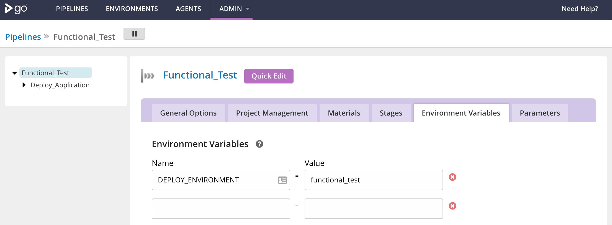

Slide 58
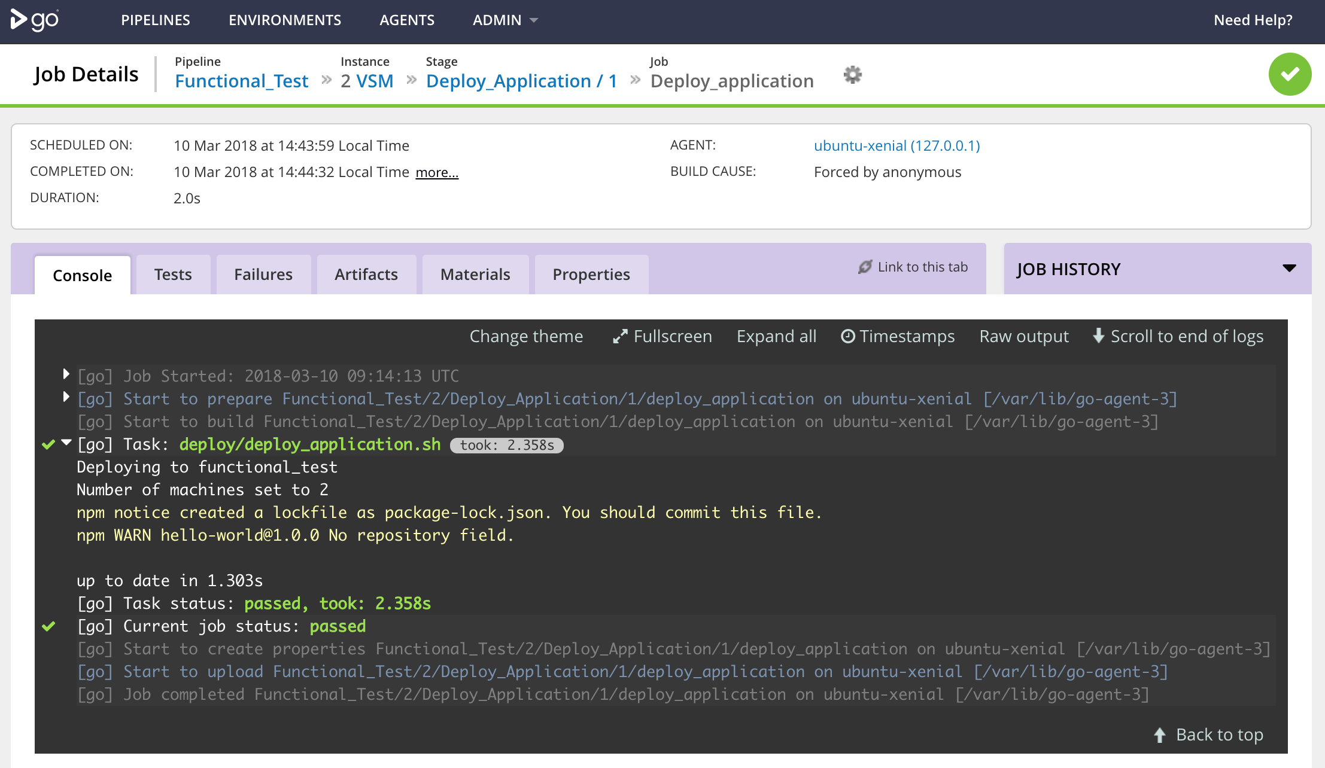

Slide 59
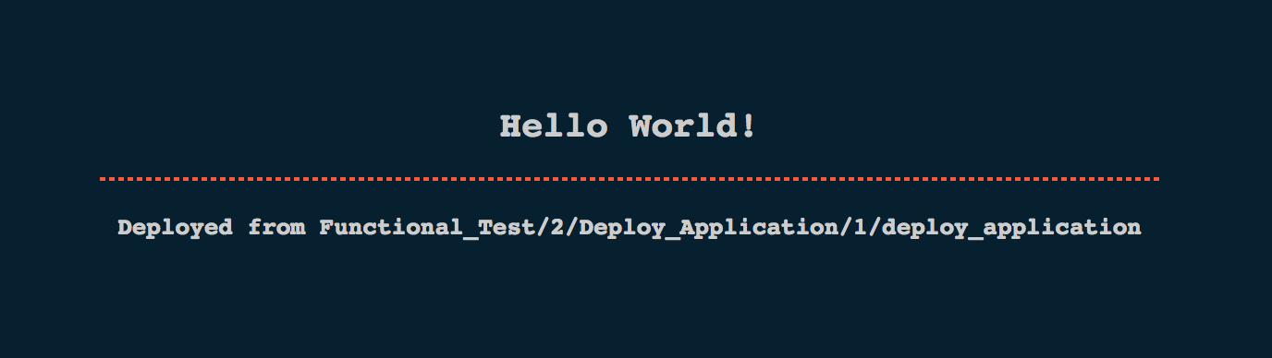

Slide 60
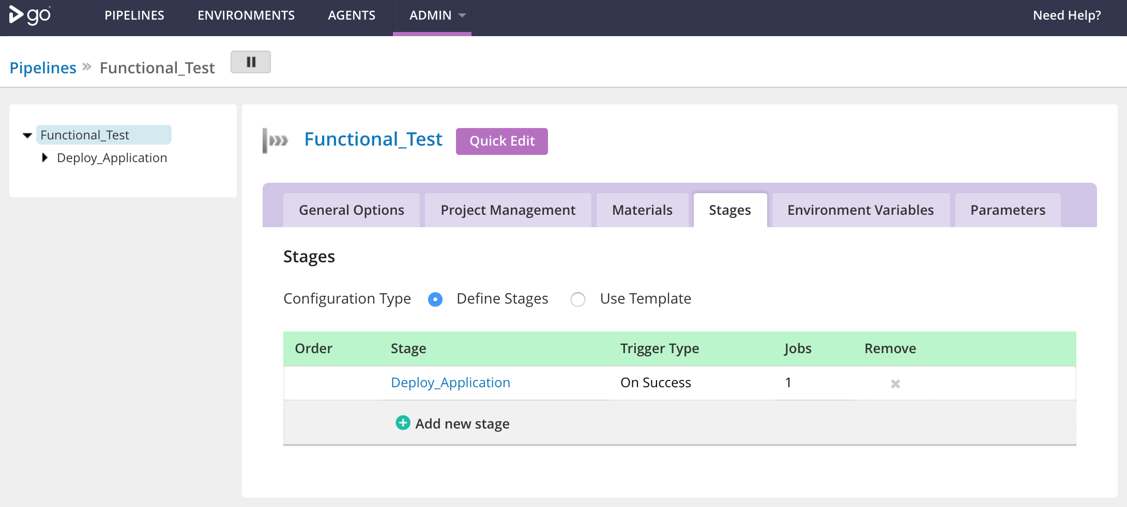

Slide 61
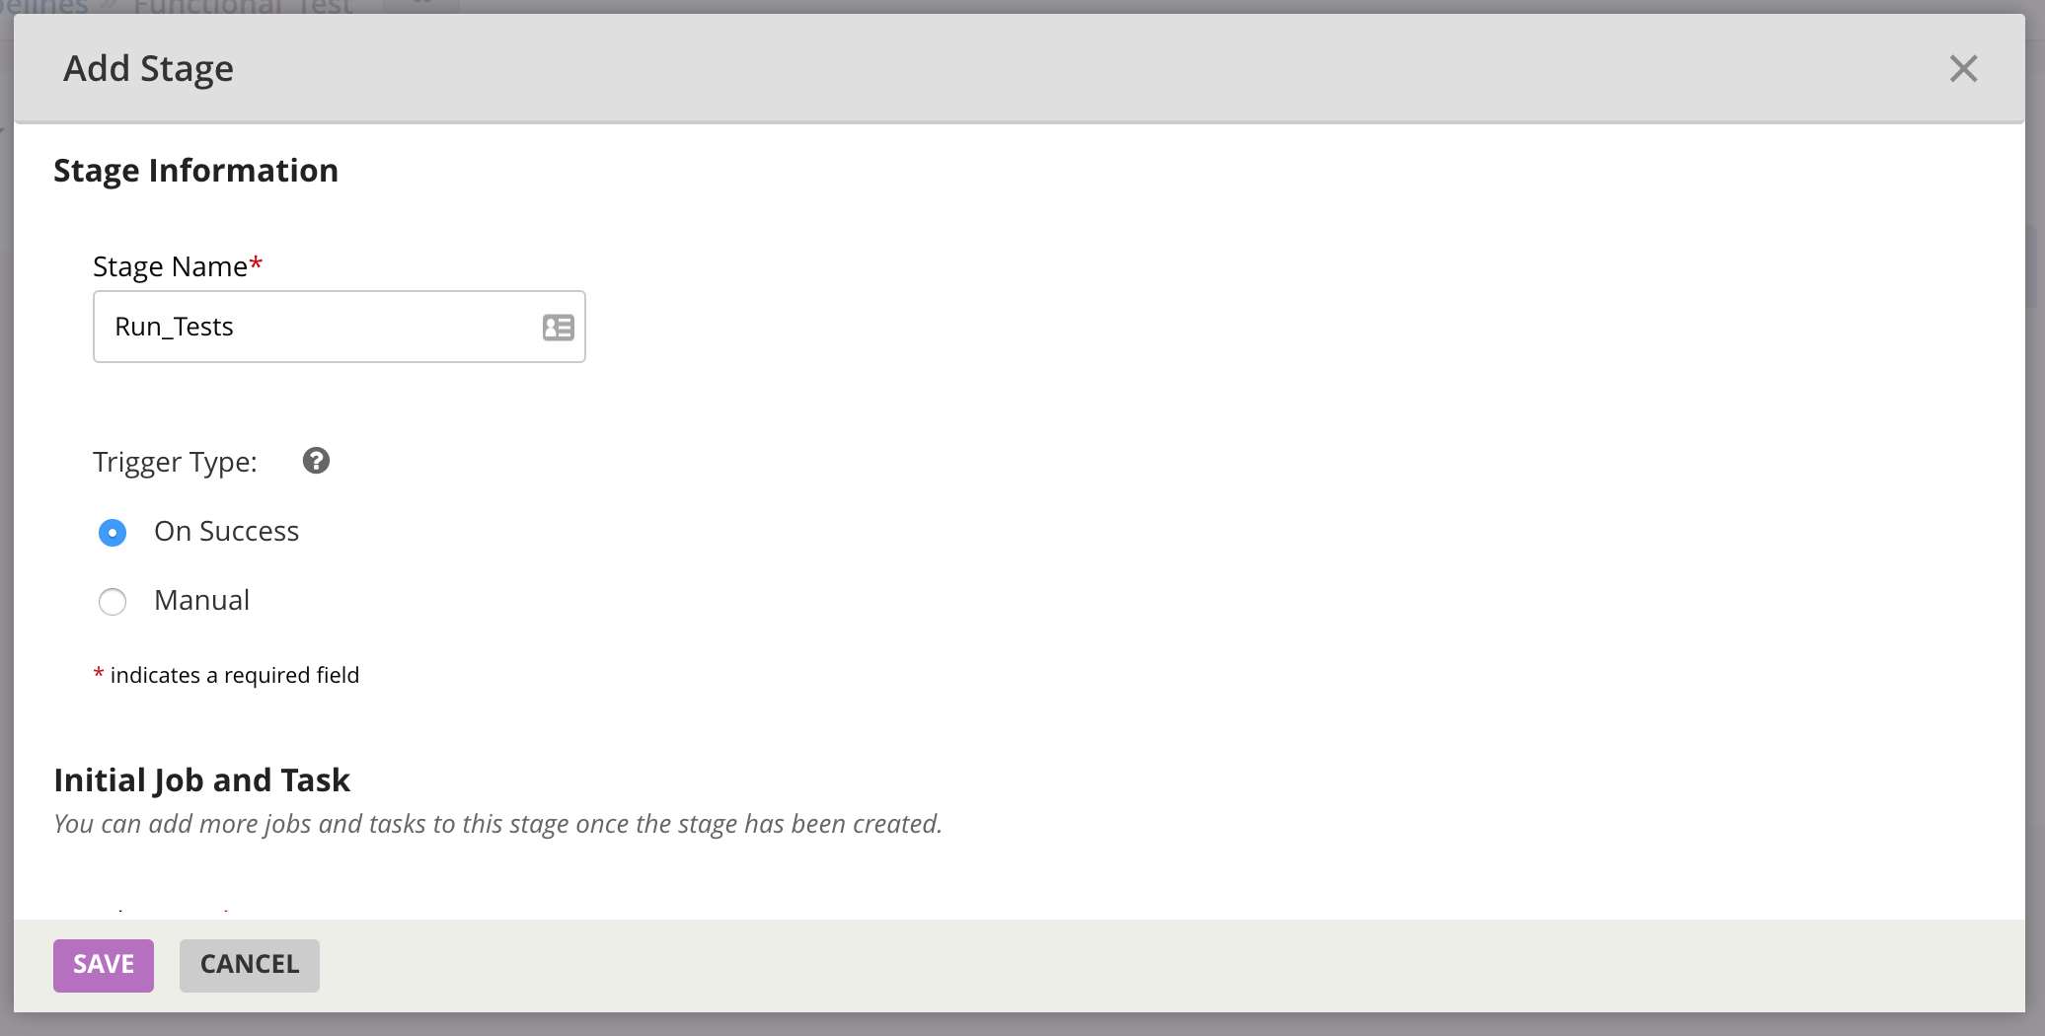

Slide 62
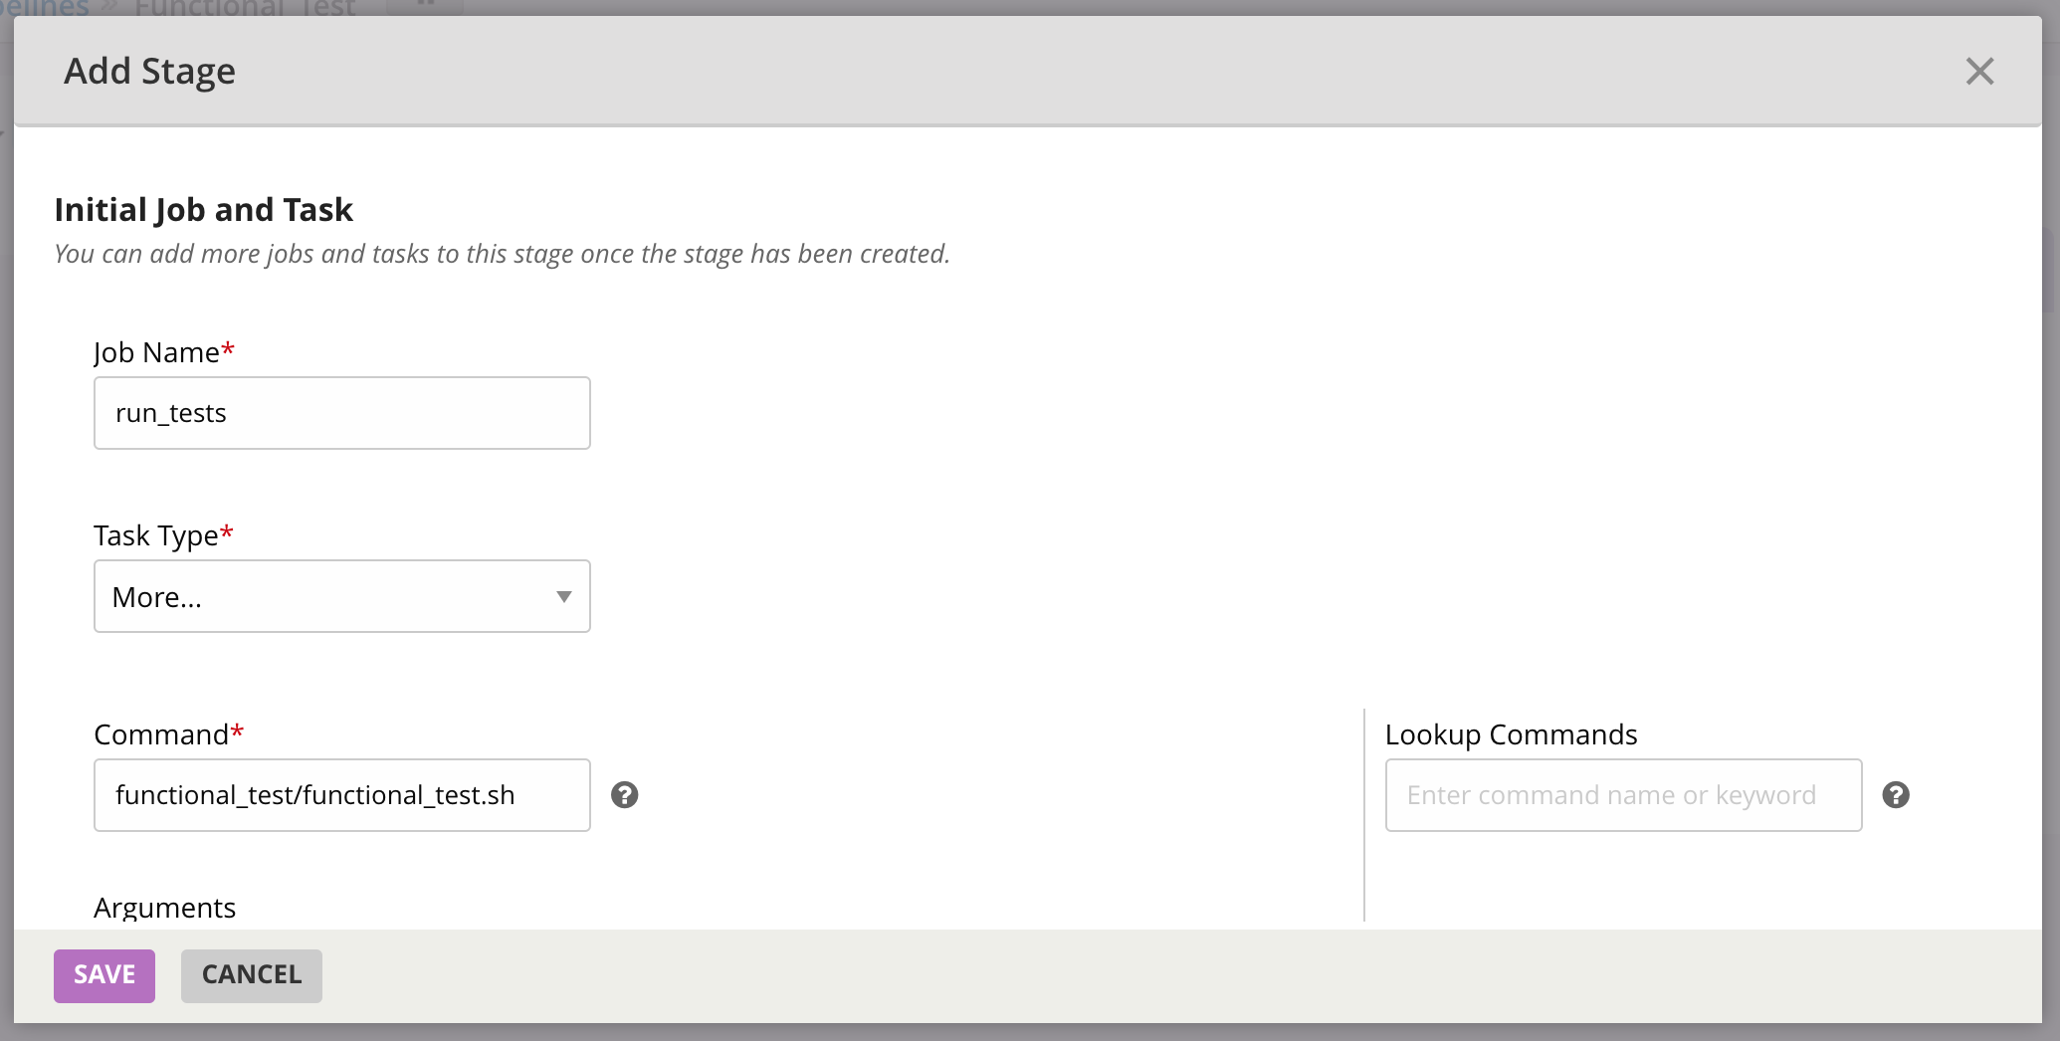

Slide 63
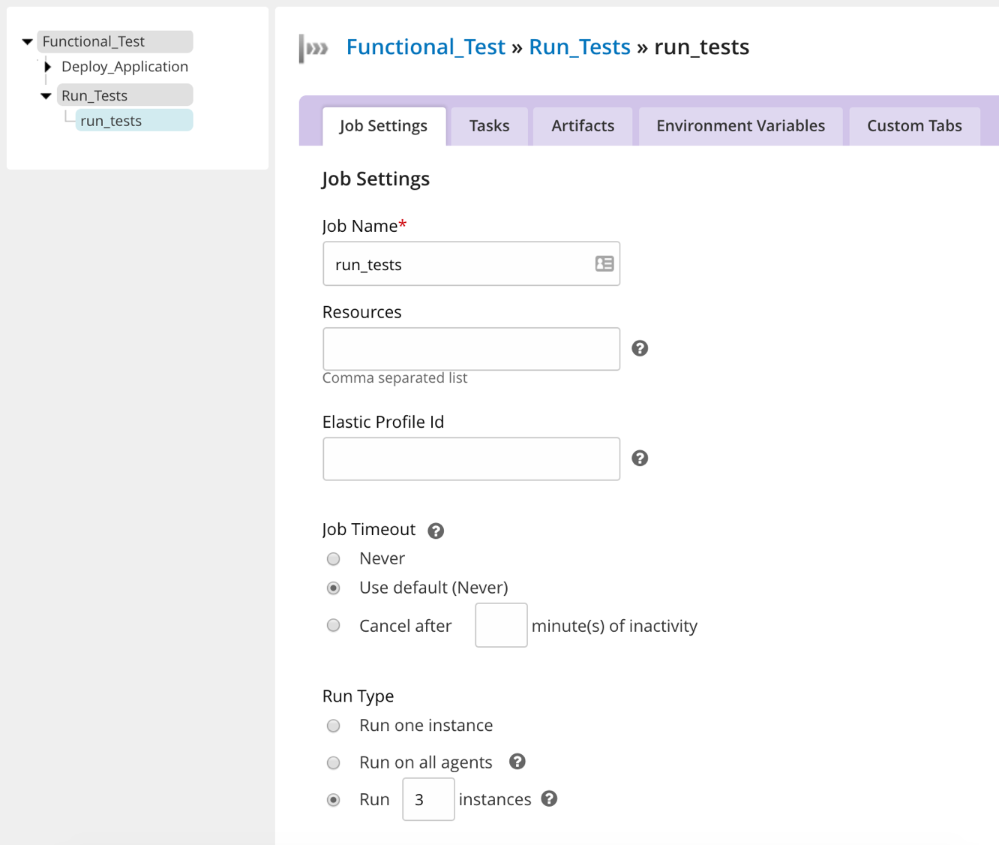

Slide 64
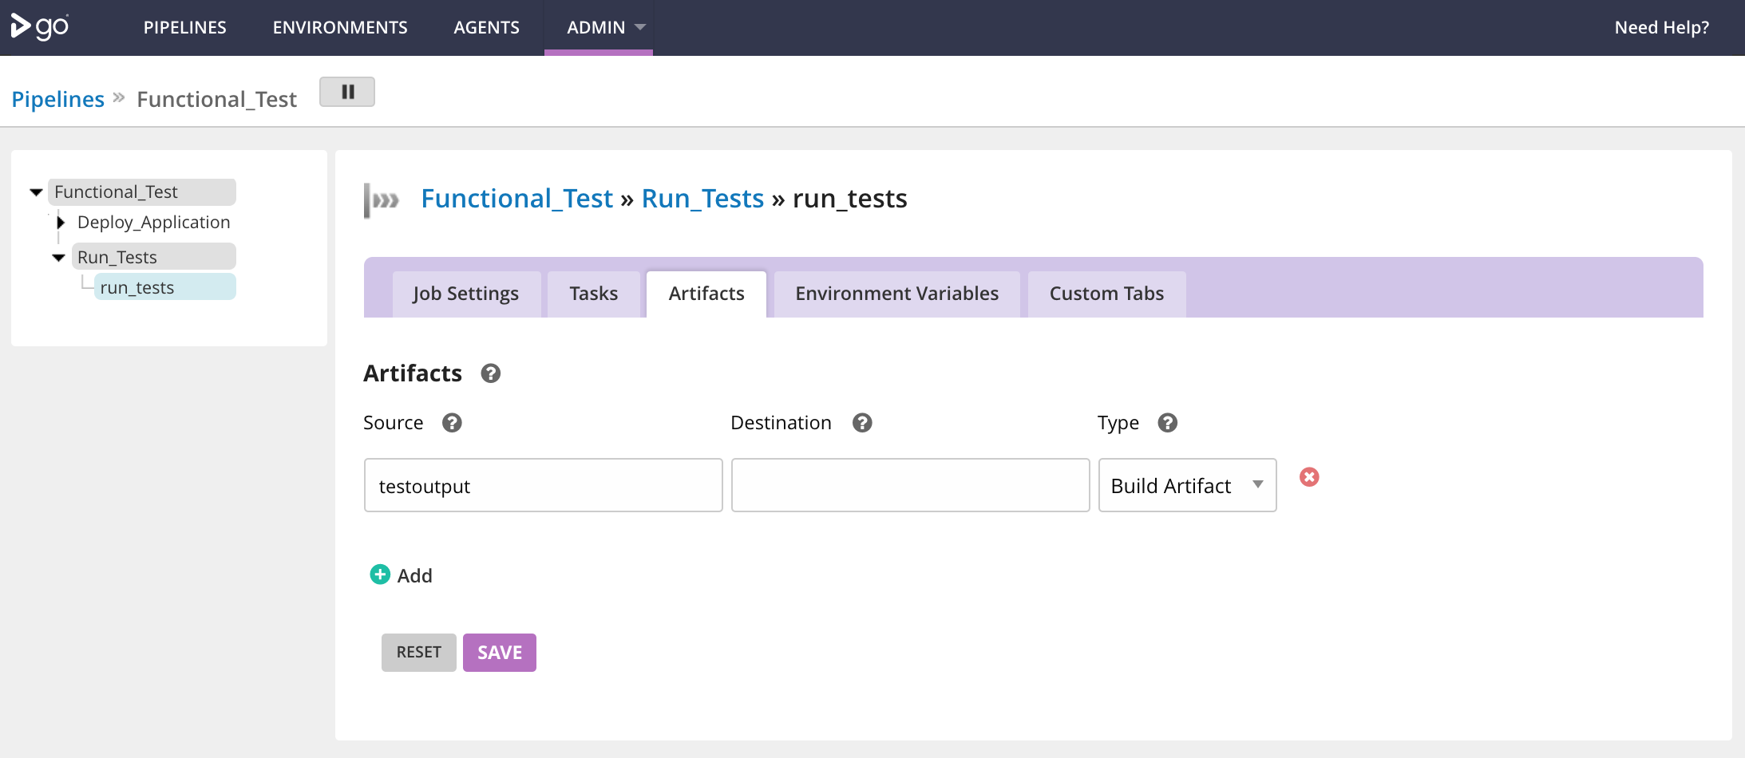

Slide 65
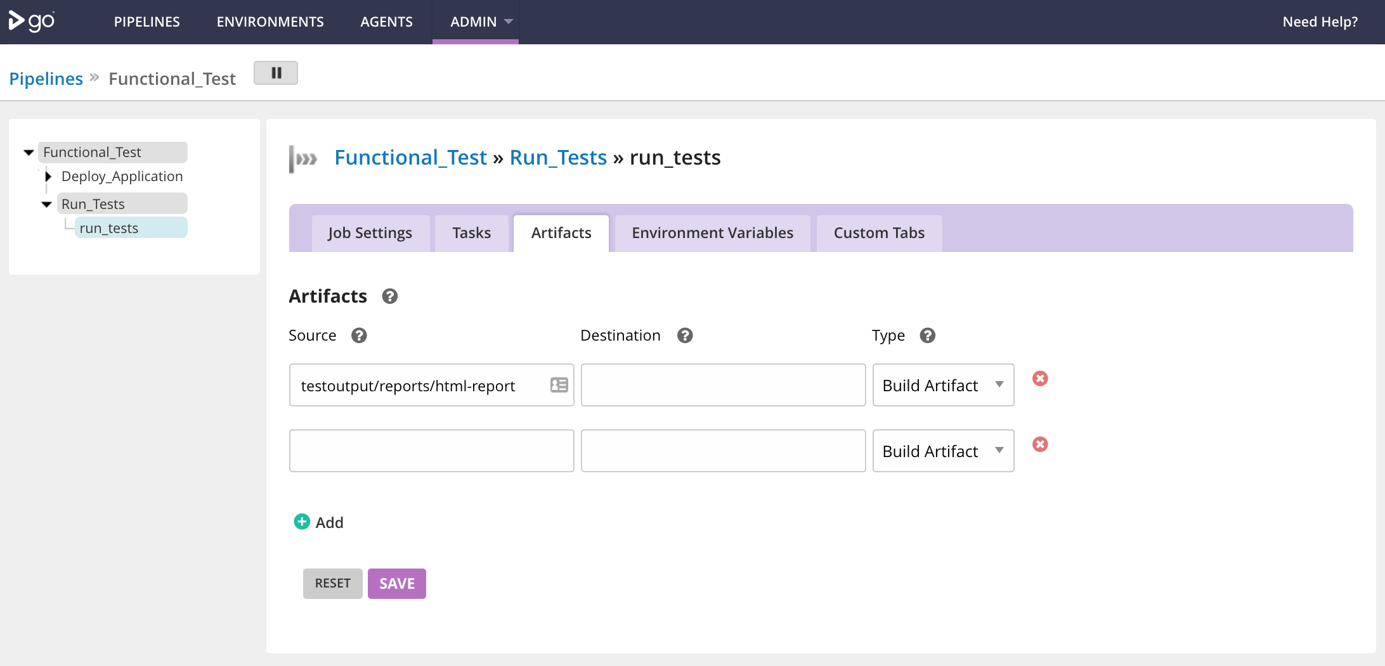

Slide 66
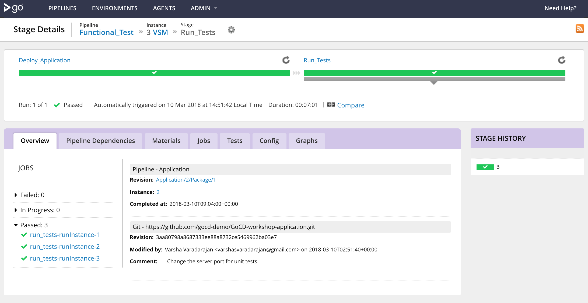

Slide 67


Slide 68


Slide 69


Slide 70


Slide 71


Slide 72


Slide 73


Slide 74


Slide 75


Slide 76


Slide 77


Slide 78


Slide 79


Slide 80


Slide 81


Slide 82


Slide 83


Slide 84


Slide 85


Slide 86


Slide 87


Slide 88


Slide 89


Slide 90


Slide 91


Slide 92


Slide 93


Slide 94


Slide 95


Slide 96


Slide 97


Slide 98


Slide 99


Slide 100


Slide 101


Slide 102


Slide 103


Slide 104


Slide 106


Slide 107


Slide 108


Slide 109


Slide 110


Slide 111


Slide 112


Slide 114


Slide 115


